Slide 1
Introduction to the Animal Sciences
Introduction to Animal Science:
Global, Biological, Social, and Industry Perspectives
W. Stephen Damron
Chapter 1

Slide 2
Learning Objectives
After studying this chapter, you should be able to:
define animal science and all of its component parts.
describe how, why, and when domestication occurred.
give an overview of the distribution of the agricultural animals worldwide.
explain the contributions of domestic animals to humans and state why they are so important to life as we know it.
describe the worldwide livestock revolution and its implications.

Slide 3
Introduction
Animals are part of our sustenance, our sociology, and our day-to-day lives.
Because of their importance in our lives, we study them and apply what we learn to improve their lives and enhance their role in our lives.
The branch of science that deals with domestic animals is animal science.

Slide 4
Introduction
Much of our use for animals revolves around their contributions to our food supply.
To coax a more stable food supply from the land, humans developed a complicated resource management system called agriculture.
In agriculture, domestic plants and animals are kept to produce for humankind’s needs.

Slide 5
Introduction
Humans have also found many other uses for domestic animals in such areas as
sports,
recreation,
manufacturing,
religion,
and as companions.
It’s easy to see that animals are at the core of virtually all of our lives; they are a dominating part of our culture.

Slide 6
Introduction
Exact dates of domestication of individual animal species is unknown.
DNA sequencing technology suggests that the dog may have been domesticated from the wolf as long as 135,000 years ago,
but archeological evidence suggests the dog was domesticated about 14,000 years ago (12,000 B.C.).

Slide 7
Introduction
Estimates for domestication of other domestic animal species are
8000 B.C.—sheep
6500 B.C.—goats, pigs, and cattle
6000 B.C.—chickens
5500 B.C.—llamas
4000 B.C.—donkeys
3500 B.C.—horses
3000 B.C.—reindeer

Slide 8
Introduction
Hunter-gatherers (who first domesticated animals) used the meat, bones, and skins just as they had done before domestication; other uses (milk, clothing, power, war, sport, and prestige) came later.
With our acquisition of domestic animals came the need to ultimately manage them, care for them, and learn to use them to our best advantage; thus animal science began.

Slide 9
Animal Science Specialties
Animal science is simply the collective study of domestic animals.
As animal scientists have learned more about animals, the accumulated information has become too large for anyone to comprehend completely.
Because of that, animal science is divided into specific disciplines, or specialties.

Slide 10
Animal Science Specialties
Animal science specialties can be broken down in many ways, but the following categories are common.
Genetics
Nutrition
Physiology
Animal health
Ethology
Meat science
Dairy product science
Biotechnology
Nutrition studies how organisms acquire and use food/feed for their bodies needs.
The most important environmental factor is feed.
Physiology is the study of the mechanisms of life from the cellular level to the whole animal.
This area includes reproductive, renal, and exercise physiology areas.
Animal health studies how diseases, parasites, and environmental factors affect animal productivity and welfare.
Disease is any state other than a state of health.
Ethology is the study of animal behavior.
Applied ethology includes welfare assessment, optimizing production, behavioral control, behavioral disorders, and behavioral genetics.
Meat science deals with the handling, distribution, and marketing of finished meat products.
Meat is defined as the edible flesh of animals that is used for food.
Dairy product science deals with the collection, handling, and marketing of milk in its many forms to the consuming public.
Biotechnology involves technological applications of biology.
This discipline has caught attention in animal science because of recombinant DNA technology.
Genetics is the science of heredity and variation of inherited characteristics.
This area includes animal breeding and the genetic code to improve farm animal production.

Slide 11
Animal Distribution
There are approximately 4.5 billion large farm animals and 19.8 billion poultry distributed throughout the world.
The number of large farm animals has been increasing at an average rate of about 1% annually for three decades.
Poultry numbers have increased more rapidly at an average rate of over 5% annually.

Slide 12
Animal Distribution
Until very recently, greater than ⅔ of the large farm animals were found in developing countries, but they produced only about a ⅓ of the meat, milk, and wool produced in the world.
Reasons for this low productivity include environmental stresses, disease challenges, lack of access to technology, and different objectives of livestock production.
However, the productivity of the livestock in the developing world is improving dramatically.

Slide 13
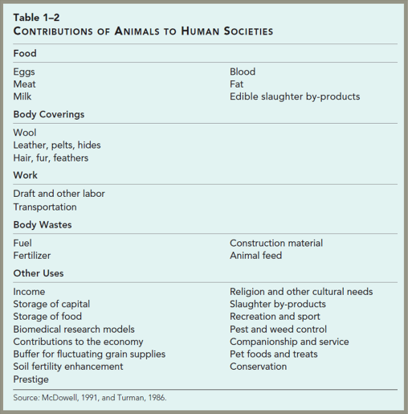
Animal Distribution
Agricultural animals have made a major contribution to the welfare of human societies for millennia by providing a variety of products and services.

Slide 14
Contribution of Animals to Humanity
Food Source
Humans are omnivores, consuming both plant- and animal-based foods.
Plants supply 82.8% of the total food energy consumed by the world’s people.
Animal products supply the remaining 17.2%.

Slide 15
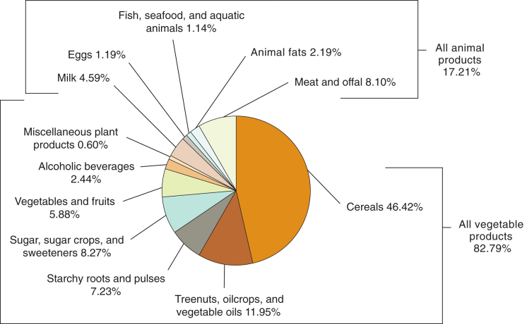
Contribution of Animals to Humanity
Figure 1-2
Contributions of food sources to human energy (calorie) consumption.
(Source: FAO, 2011a.)

Slide 16
Contribution of Animals to Humanity
Food Source
Animals are a more important source of protein than they are of calories, supplying 38.5% of the protein consumed in the world.
Of the animal protein sources,
meat supplies approximately 49.5%,
milk provides approximately 25.8%,
fish supplies approximately 16%,
and eggs supply 8.7%.

Slide 17
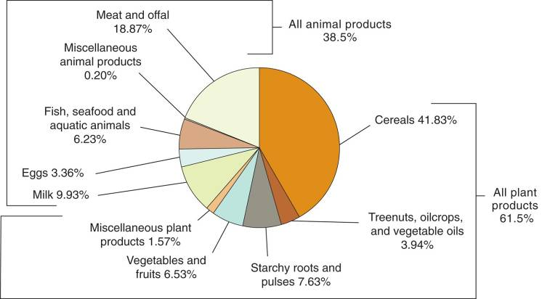
Contribution of Animals to Humanity
Figure 1-3
Contributions of food sources to human protein consumption.
(Source: FAO, 2010a.)

Slide 18
Contributions of Animals to Humanity
Food Source
Meat, eggs, and dairy products are important food sources because they are nutrient dense.
This means they have many nutrients compared to their calories, and the nutrients are digestible and readily available.
Animal foods are an important source of vitamins and minerals, and the protein in animal foods is more likely than are plant proteins to include the essential amino acids in the correct proportions.

Slide 19
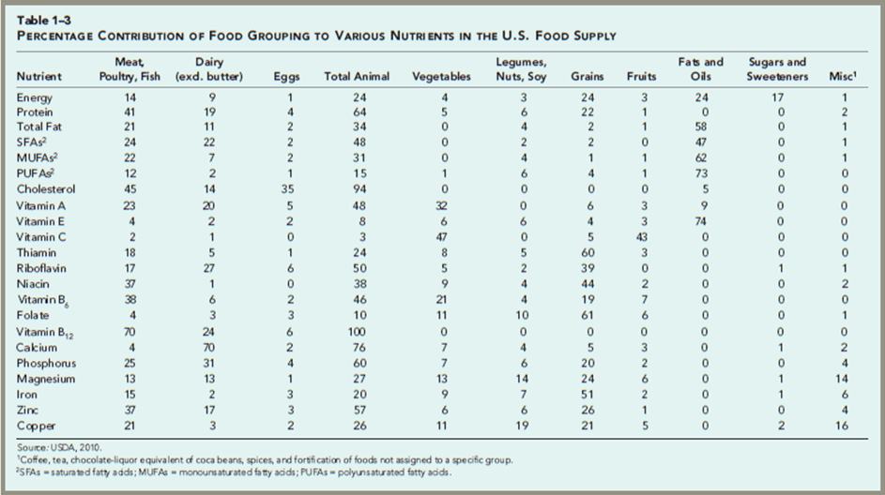
Contributions of Animals to Humanity

Slide 20
Contributions of Animals to Humanity
Food Source
Absolute food quantity and amount of animal products are more available to some of the world’s peoples than to others.
Approximately 27% of the calories in the average diet in North America is from animal products compared to 7.4% for the average African.
There is also a tremendous difference in food distribution to the world’s peoples.
Globally, over 1 billion people are undernourished.

Slide 21
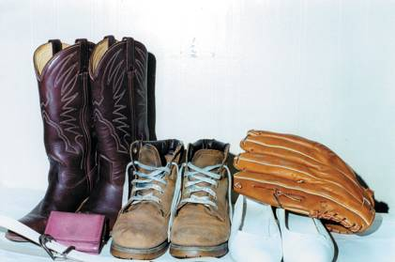
Contributions of Animals to Humanity
Other Uses
In addition to food, other animal products are also of great importance to humans who have used wool, hair, and other fibers, feathers and hides for millennia for clothing and other uses.
Figure 1-4
Hides are a slaughter by-product that humans have used since long before domestication. (Photo courtesy of Adele M. Kupchik.)

Slide 22
Contributions of Animals to Humanity
Other Uses
Manure from animals is a valuable by-product used for fertilizer and other applications.
Slaughter by-products are the source of a large number of industrial and consumer products.
Figure 1-6
Slaughter by-products are used in the manufacture of a variety of industrial and consumer products. (Photo courtesy of Adele M. Kupchik.)

Slide 23
Contributions of Animals to Humanity
Other Uses
Draft animals are important to many Asian, African, and Latin American countries.
Animals are used as models for humans in biomedical research.
Animal research also benefits animal health, resulting in healthier, longer-lived pets and healthier, more productive livestock.

Slide 24
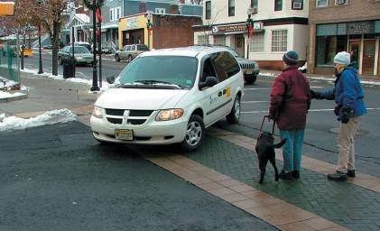
Contributions of Animals to Humanity
Other Uses
Specially trained animals assist people with visual, hearing, and other disabilities.
Many entertainment industries such as racing, rodeos, and bull-fighting are based on the use of animals.
Figure 1-9
Service dogs help people with disabilities. Here, a Seeing Eye® dog in action with student and instructor. (Photo courtesy of The Seeing Eye, Inc. Used with permission.)

Slide 25
Contributions of Animals to Humanity
Other Uses
Agricultural animals convert inedible feeds to valuable products.
About ⅔ of the feed in the U.S. livestock is not suitable for human consumption including
hay,
pasture,
coarse forages,
by-products,
garbage,
and damaged food.

Slide 26
The Future of Livestock Production
Global livestock production is undergoing huge increases in animals and products with further increases predicted.
To keep pace with demand, many are predicting the need to double animal product output by 2050.
The world’s human population is expected to reach approximately 9 billion by 2050.
This increasing animal production is being referred to as the livestock revolution.

Slide 27
The Future of Livestock Production
The forces driving increased global demand for animal products are simple:
human population growth
and increasing income.
These factors are causing increased per capita consumption of animal products and large increases in total demand.
Most of this demand is coming from developing countries.

Slide 28
The Future of Livestock Production
The world’s developing demand for biofuel production will increasingly play a role in food availability and prices.
The prime agricultural lands are already in use, and, worldwide, the potential new agricultural lands are covered by forests, under human settlements and infrastructure, or likely to be marginally productive.

Slide 29
The Future of Livestock Production
The challenges associated with these profound changes in agriculture are significant.
Agricultural lands will need to be more productive emphasizing the need for research and subsequent technology development to increase productivity per unit of land.
For the sake of future generations, we must achieve these massive increases in yield while protecting air, soil, and water quality.

Slide 30
Summary and Conclusions
Animal science began to address the challenges that the first domesticators of animals encountered many millennia ago.
Today, animal science is a vital field with various specialties.
Animals are used for many purposes, including food, fiber, work, research, companionship, and entertainment.
The number of agricultural animals is steadily increasing, and they are becoming more important in helping to feed the human population.

