Slide 1
The Value of Animals to Humanity
Introduction to Animal Science:
Global, Biological, Social, and Industry Perspectives
W. Stephen Damron
Chapter 2

Slide 2
Learning Objectives
After studying this chapter, you should be able to:
describe the value of animal products in providing for the world’s food.
explain the current rates of growth or decline of animal products on a worldwide basis.
elaborate on the milk-producing species, state their importance to world milk production, and understand what is happening to world milk production.
describe the value of eggs in feeding the world’s people.
develop a modest understanding of some miscellaneous food uses for the world’s animals.
explain the value animal products in the human diet.
give a good overview of all the many nonfood uses humans have for the world’s animals.

Slide 3
Introduction
What did humans derive from domestication?
Why do we need domestic animals in today’s world?
Goods and services from the world’s animal populations supply many social, religious, and economic functions in addition to food.

Slide 4
The Food Uses of Agricultural Animals
Red Meat and Poultry Production
The nutrients provided by meat are important for human survival.
Protein and energy from meat products are quantitatively and qualitatively important in our diet.
Substantial shares of the vitamins and minerals needed in human diets are contributed by meat products.
Annual per capita meat supply ranges from over 300 lbs. in affluent countries to very little in poor countries.

Slide 5
The Food Uses of Agricultural Animals
Red Meat and Poultry Production
Annual per capita meat supply ranges from over 300 lbs. in affluent countries to very little in poor countries.
World meat production has increased steadily for many years at an average rate of 2% per year.

Slide 6
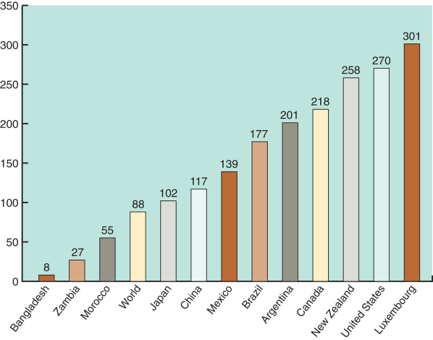
The Food Uses of Agricultural Animals
Figure 2-1
Per capita meat supply in pounds, selected countries and the world.
(Source: FAO, 2011.)

Slide 7
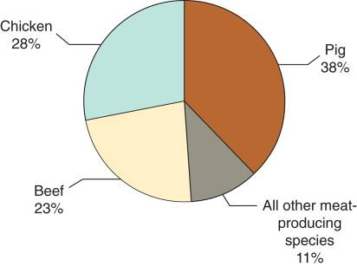
The Food Uses of Agricultural Animals
Red Meat and Poultry Production
Pork, chicken, and beef produce 89% of the world’s meat supplies.
The pig is the most important meat source, producing 38% of the world’s meat.
Pork production is increasing at the rate of approximately 1-2% per year.
Figure 2-3
Relative contribution of the major meat species to world meat supplies. (Source: FAO, 2011.)

Slide 8
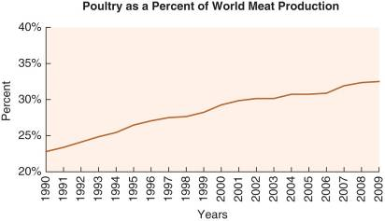
The Food Uses of Agricultural Animals
Red Meat and Poultry Production
Chicken is the second most important meat source, supplying 28% of the world’s meat.
Poultry meat production is growing the most rapidly at almost 3% per year, more than doubling since 1990.
Production from other meat-producing species is increasing 1-2% yearly.
Figure 2-4
World poultry-meat production is increasing more rapidly than any other meat. (Source: FAO, 2011.)

Slide 9
The Food Uses of Agricultural Animals
Red Meat and Poultry Production
Economic development in many countries has increased incomes, thus providing the economic means to a better diet for more people.
Invariably, people demonstrate their willingness to purchase more meat for their diets as soon as they are able to afford it.

Slide 10
The Food Uses of Agricultural Animals
Edible Slaughter By-Products
Once the products of greatest value have been removed from the carcass, the substances and products remaining still have value; we refer to these as by-products.
In developed countries, these are often considered specialty foods and are called variety meats.
Most are organ meats (e.g. liver, kidney,tongue, sweetbread) and are often considered delicacies.

Slide 11
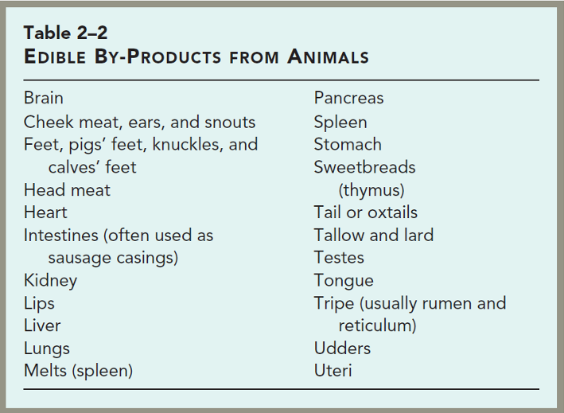
The Food Uses of Agricultural Animals

Slide 12
The Food Uses of Agricultural Animals
Edible Slaughter By-Products
In the U.S., we are not as fond of the variety meats as is the rest of the world, so we export large quantities to Europe and other countries.
Liver is the most widely used; brains and spinal cords are no longer consumed in some parts of the world because of concerns over the transmission of bovine spongiform encephalopathy.

Slide 13
The Food Uses of Agricultural Animals
Milk and Milk Products
Milk provide much-needed protein, energy, minerals, and vitamins to humankind’s diet.
Annual per capita whole milk supply ranges from over 500 lbs per year in some countries to little or none in others.
Total world milk production had increased slowly over the last two decades; world milk production is increasing approximately 2% per year.

Slide 14
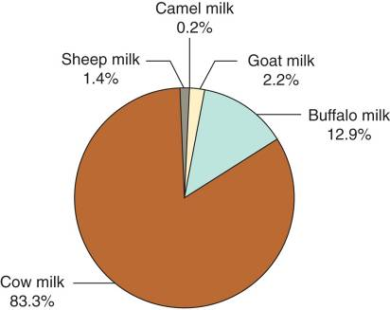
The Food Uses of Agricultural Animals
Milk and Milk Products
Several different species contribute to worldwide milk production.
Cattle supply 83% of the world’s milk supply.
Buffalos supply 13% of world’s milk.
Most of the remainder of milk comes from sheep, camels, and goats.
Figure 2-6
Relative percentage of world milk supply by species. (Source: FAO, 2011.)

Slide 15
The Food Uses of Agricultural Animals
Milk and Milk Products
Humans use almost 700 million metric tons (MT) of milk per year, including fluid and processed milk.
Often, dairy products supply the major source of fat in human diets.
In addition to adding flavor to high-starch foods (e.g. rice and root crops), fats also provide needed calories and essential fatty acids to the diet.

Slide 16
The Food Uses of Agricultural Animals
Milk and Milk Products
Dairying has been promoted in the developing countries for several decades by several major international agencies for several reasons.
In addition to improving nutrition, it also provides year-round employment (as opposed to crops that have seasonal labor needs).
The year-round income bolsters the overall economy.
Dairying is also a very efficient means of converting animal feed to people food.

Slide 17
The Food Uses of Agricultural Animals
Poultry and Eggs
In addition to meat, the various poultry species produce a second high quality product—eggs.
Poultry offer great potential for improving the nutritional levels of all the world’s peoples.
Poultry require a low investment and, if necessary, can produce some food for their owners with only a minimal input in terms of feed, housing, and equipment.

Slide 18
The Food Uses of Agricultural Animals
Poultry and Eggs
Eggs are an important global food source from both a volume and quality perspective.
Chickens produce most of the eggs for human consumption; and production is increasing at a rate of approximately 2.2% per year worldwide.
Ducks, turkeys, geese, and guinea fowl also contribute to global egg production, but to a much lesser degree.

Slide 19
The Food Uses of Agricultural Animals
Poultry and Eggs
Eggs are an excellent source of high-quality protein and fat.
The protein is important to all economic classes.
For poor societies, the fat content is a positive factor because it provides calories and essential fatty acids.

Slide 20
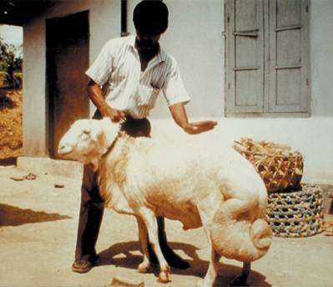
The Food Uses of Agricultural Animals
Miscellaneous Food Uses
Animals provide several additional foods to humans.
These include:
honey,
blood,
fat,
and hides/skins are eaten by some cultures.
Figure 2-8
The fat from the tails of fat-tailed sheep is collected from live animals.

Slide 21
The Food Uses of Agricultural Animals
Value of Animal Products in the Human Diet
Animal products are a very important part of human diets because they are high-quality foods.
They are excellent sources of protein, energy, minerals, and essential vitamins.
The nutrient availability is good and the nutrient density is high.

Slide 22
The Nonfood Uses of Agricultural Animals
There is a great variety of important contributions that various species of domestic animals provide for humans in addition to food.
Some of these uses are outside the social context of people who live in developed countries, which makes it difficult for us to understand the great magnitude of these contributions to people’s lives.

Slide 23
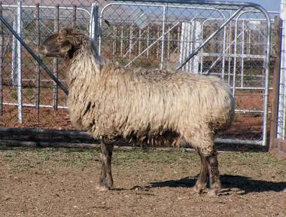
The Food Uses of Agricultural Animals
Body Coverings
The most important products from some animals are their body coverings.
Examples are:
sheep (wool and Persian lambskins),
goats (cashmere and mohair),
and alpacas.
Figure 2-10
The Karakul sheep produces Persian lambskins that are used in the manufacture of luxurious coats. (Photo courtesy of Keith Ramsay.)

Slide 24
The Nonfood Uses of Agricultural Animals
Body Coverings
A major advantage of the fiber products is that they are renewable—they can be harvested repeatedly from the same animal.
Skins and hides are nonrenewable, at least from the same animal.
In countries with a highly developed agriculture, the skins and hides are a valuable by-product, but their value is relatively small compared to the carcass.

Slide 25
The Nonfood Uses of Agricultural Animals
Body Coverings
As one might expect, cattle hides, wool, and sheepskins are produced in greatest volume.
Other body coverings include:
mohair and cashmere from goats,
camel hairs used for fabrics or paintbrushes,
yak hairs used in clothing and horse blankets,
and feathers used in pillows, bedding, jewelry, and many other items.

Slide 26
The Nonfood Uses of Agricultural Animals
Power Sources
In developed agriculture, almost all farm power is provided by machines rather than by animals.
In developing countries, 50% of the arable land is tilled by draft animals.
As a general rule, the poorer the country, the greater the dependence on animal power.

Slide 27
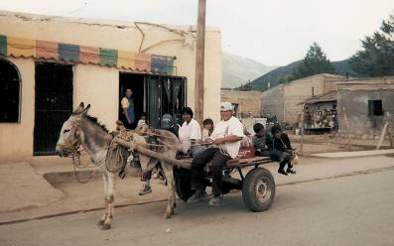
The Nonfood Uses of Agricultural Animals
Power Sources
Several species of domestic animals are used for plowing, pulling carts or sleds, and packing.
The major species used for draft purposes are:
oxen,
donkeys,
horses,
buffalos,
mules,
and camels.
Figure 2-14

Slide 28
The Nonfood Uses of Agricultural Animals
Body Wastes
Manure
As many as ½ of the world’s farmers depend on animal manure and compost from plant residues as their only source of fertilizer.
However, a recent study determined that only 5% of U.S. cropland is fertilized with livestock manure, and most of that is from dairy and hog operations.

Slide 29
The Nonfood Uses of Agricultural Animals
Body Wastes
Manure
In many of the poorer areas of the world, manure must be used as a fuel.
Dried manure, particularly from cattle and buffalo, is an important source of fuel for cooking and heating.
A third use of manure is for construction.
Many people in Africa, Asia, and parts of South America uses manure as a plaster for their homes.
In other cultures, cow manure is used as an important ingredient in poultices for wound healing.

Slide 30
The Nonfood Uses of Agricultural Animals
Body Wastes
Urine
Urine is used to enhance soil fertility in many parts of the world due to its nitrogen, phosphorus, and potassium content.
Urine has multiple uses in several cultures including:
to control dust and pests,
extend the low volume of milk available for human food,
manufacture of leather and other textiles,
a rinse for a person’s hair,
and even used in medicinals, and religious ceremonies.

Slide 31
The Nonfood Uses of Agricultural Animals
Pest and Weed Control
Land that is being left to fallow (rest) can be grazed by animals to control weeds, and the manure rejuvenates the soil.
Grazing animals can be used to reduce insect populations lessening damage to neighboring crops and also controlling insect-borne diseases in the human population.
The use of animals to control insects and weeds has potential for the developed world as a means of reducing the use of pesticides in certain areas.

Slide 32
The Nonfood Uses of Agricultural Animals
Storage of Capital and Food
In many of the poorer developing countries, banks are nonexistent or are scarcely used.
As an alternative to banks, people use livestock (particularly cattle) as a vehicle for storing their surplus capital.
If money is needed, animals can be sold or often bartered for other needed items.

Slide 33
The Nonfood Uses of Agricultural Animals
Storage of Capital and Food
Uses of livestock for storage of capital has several undesirable effects.
Clearly, large herds are desirable, however severe overgrazing often results which can lead to desertification of lands.
A second very undesirable effect is the reluctance of people to sell animals unless money is needed.
This prevents the development of an orderly program of marketing and slaughtering animals such as that found in the developed countries.

Slide 34
The Nonfood Uses of Agricultural Animals
Storage of Capital and Food
The use of animals as storage of food is important in many countries because animals represent one of the most reliable reserve food supplies.
Most poor countries have inadequate facilities for storing grain without suffering losses from pests; this is not a problem with animals.
Animals assume even greater importance in the storage of food in countries subjected to periodic and prolonged droughts.

Slide 35
The Nonfood Uses of Agricultural Animals
Cultural Uses
Exhibitions and Spectator Sports
The animal industries have long used show as a means of promoting their breeding stock to potential buyers.
Activities such as rodeos, fighting (bulls, buffalo, sheep, and chickens), and racing (camels, horses, buffalo, dogs, fowl, turtles, and frogs), together provide billions of person days of recreation annually.
These animal recreation events represent a source of entertainment and contribute to the economy.

Slide 36
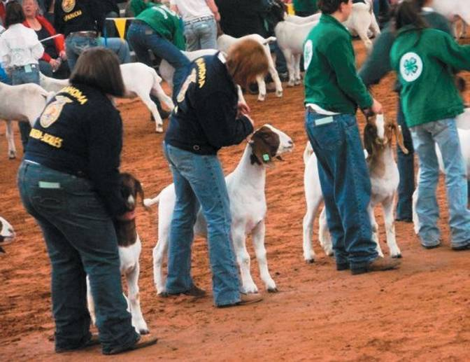
The Nonfood Uses of Agricultural Animals
Figure 2-20
Exhibition of livestock has a social dimension, in addition to helping promote breeding stock to potential buyers. (Photo courtesy of Keillie Whipple. Used with permission.)

Slide 37
The Nonfood Uses of Agricultural Animals
Cultural Uses
Companionship and Service
The dog and the cat have long and venerable histories of companionship and service to humans; however, other species are also used.
Modern research has demonstrated a myriad of benefits to humans from animal companionship.
In addition, Seeing Eye dogs, hearing-ear dogs, monkeys to assist paraplegics, drug-search dogs, and a variety of others make valuable contributions to humanity.

Slide 38
The Nonfood Uses of Agricultural Animals
Cultural Uses
Social Structure
The less developed the agriculture, the more livestock are a part of the cultural fabric of people.
Animals play an important role in the traditional way that formal contracts are sealed and social obligations are met.
One example is the involvement of livestock exchange in marriage contracts.

Slide 39
The Nonfood Uses of Agricultural Animals
Nonfood or Inedible Slaughter By-Products
A large number of nonfood products are derived from slaughter at all levels of development.
In developing countries, various by-products are become jewelry, religious implements, tools, fuel, construction material, or musical instruments.
In developed countries, many pharmaceutical and drugs are extracted from animal organs and other tissues.

Slide 40
The Nonfood Uses of Agricultural Animals
Nonfood of Inedible Slaughter By-Products
These by-products represent multibillion-dollar industries worldwide.
Examples include:
intestines become sutures;
pigskin is used to help burn victims;
many inedible meats are used in pet foods;
bones and hooves become fertilizer;
inedible fat can be used in many products like lubricants, crayons, detergents, and livestock feeds.

Slide 41
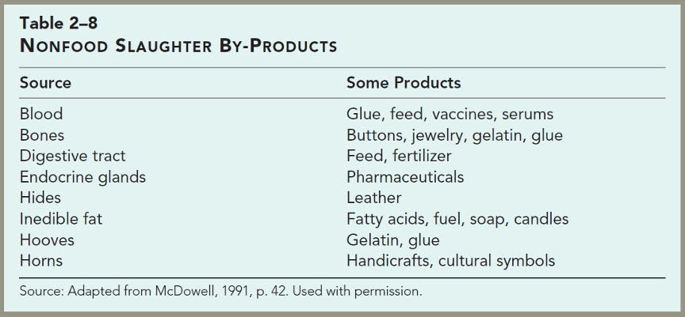
The Nonfood Uses of Agricultural Animals

Slide 42
The Nonfood Uses of Agricultural Animals
Human Health Research
The number of animal applications to health research are simply too numerous to mention.
The average American life span increased by 30 years in the 20th century; much which was due to health research conducted on animals.
Rodents have been the most important species used; however, in recent decades, other traditional livestock species are proving very useful.

Slide 43
The Nonfood Uses of Agricultural Lands
Human Health Research
Recombinant DNA technology is making animals in research an even more promising aid in fighting disease; for example, animals have been genetically engineered to mimic human disease conditions.
In addition, xenotransplantation, the replacing of human organs with those from animals, is an active and promising area of research.

Slide 44
The Nonfood Uses of Agricultural Animals
Income
In developed countries, animal agriculture is a highly specialized means of using land and labor to generate earnings.
In developing countries, animals are frequently the major source of income generated from the farm.
Conservation
Domestic animals play vital roles in many land- and water-conservation practices.
The entire concept of sustainable agriculture often depends on having animals in the system.

Slide 45
Summary and Conclusion
Agricultural animals help humans extend their use of the available resources by converting nonedible material to humanly edible food.
The high biological value of protein, coupled with vitamins and minerals, makes animal products an essential part of the human diet.
Animals a myriad of other services in addition to providing food without which humans’ standards of living would be difficult to maintain.

