Slide 1
Factors Affecting World Agricultural Structure
Introduction to Animal Science:
Global, Biological, Social, and Industry Perspectives
W. Stephen Damron
Chapter 3

Slide 2
Learning Objectives
After studying this chapter, you should be able to:
explain the process of adaptation.
list the five major categories of environmental stressors and tell how animals react to them.
describe the climatic environments of the world.
summarize how climate and natural vegetation are tied together.
explain how social and cultural differences affect agriculture.
integrate information on levels of economic and agricultural development to explain how they are linked.

Slide 3
Introduction
To understand how animals are useful to humanity, we must understand the factors that influence where and how animals live.
Various social and cultural norms have a tremendous influence on what people value, tolerate, and eat.
A successful domesticated species has adapted to its environmental conditions (natural and man-made) and has been of some use to humans.

Slide 4
Adaptation
Adaptation is the sum of the adjustments occurring in an organism that promotes its welfare and favors its survival in a specific environment.
The environment is all of the combinations of conditions under which an organism must live.

Slide 5
Adaptation
Agricultural animals must have the ability to adapt to the natural environment and artificial environment imposed by humans.
This ability to adapt to a symbiotic relationship with humans and the stresses imposed by that association is a key to domestication.

Slide 6
Adaptation
The natural environment is important because agriculture must always be practiced within its constraints and refers to climate, geography, altitude, feed, and other such factors.
The artificial environment to which agricultural animals must is a mixture of factors linked to the economic level and culture of a given society, as well as the steps taken to control the natural environment.

Slide 7
Adaptation
Stress affects the distribution and utilization of the agricultural animals of the world.
The stresses of the natural and/or artificial environment may be classified as:
climatic stresses,
nutritional stresses,
internal stresses,
geographical stresses,
and social stresses.

Slide 8
Adaptation
Climatic Stresses
Climate is the long-time pattern of meteorological factors; weather is the immediate condition of these factors in a given area.
The most important of these meteorological factors affecting animal comfort and performance are:
ambient temperature,
precipitation,
solar radiation,
wind,
and relative humidity.

Slide 9
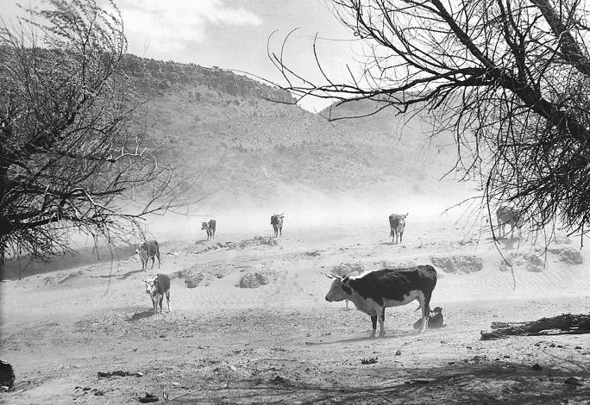
Adaptation
Figure 3-1 These cattle are in a dust storm on a sparse range in New Mexico. They are being stressed by the climate and its effects. (Photo courtesy of the U.S. Department of Agriculture.)

Slide 10
Adaptation
Nutritional Stresses
These are the stresses related to the quantity and quality of available feedstuffs and are usually determined by climatic conditions such as temperature and rainfall.
Internal Stresses
These are the stresses that affect an individual animal by gaining entrance into the body; common internal stresses are pathogens and toxins.

Slide 11
Adaptation
Geographical Stresses
These are the nonclimatic stresses associated with a particular geographic location including altitude and the terrain.
Social Stresses
These are stresses associated with the interactions of an animal with other animals including those within the same species; the most important social stresses are associated with humans.

Slide 12
Artificial Environments
Humans create artificial environments to make animals best serve us, and the specific nature of the artificial environment depends on the service demanded from the animals.
This service is usually the maximum production of some useful product such as food or body covering but can also include work, transportation, or religion.

Slide 13
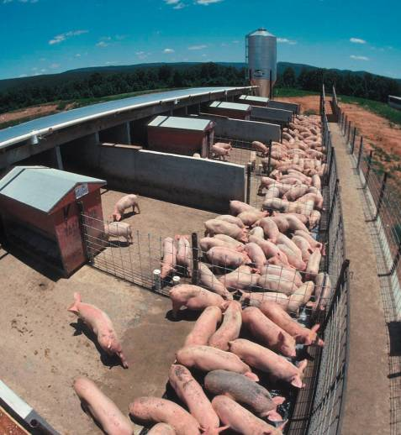
Artificial Environments
Figure 3-5
Artificial environments like this pig feeding facility are created to help coax optimum production of useful products from available resources. (Photo courtesy of the USDA-NRCS.)

Slide 14
Adaptive Changes
The adjustments (changes) that occur in individual animals adapt to specific environments are of three types:
Morphological or anatomical changes are changes in form and structure.
Physiological changes are primarily changes in the biochemistry of the body.
Behavioral changes can be genetically induced behaviors or learned responses to the environment.

Slide 15
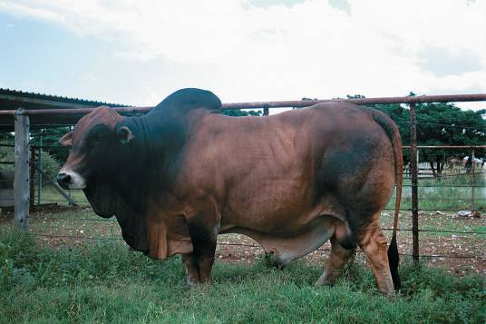
Adaptive Changes
Figure 3-7
The Boran cattle breed has adapted through anatomical changes such as pendulous ears and sheaths to dissipate heat, light coloring to reflect solar radiation, and special muscles under the skin that help to shake off parasites. Changes in its physiology help conserve water and nitrogen. Behavioral adaptations include modified grazing behaviors.(Photo courtesy of Keith Ramsey. Used with permission.)

Slide 16
Climatic Environments of the World
Tropical Climates
Tropical climates are located between the Tropic of Cancer and the Tropic of Capricorn.
The major climatic variation from season to season in the tropics is the amount and distribution of rainfall.
The tropical climates are classified into humid and subhumid areas based on the length of the rainy season.

Slide 17
Climatic Environments of the World
Tropical Climates
The humid tropics are covered in dense rain forests and are only slightly used for agriculture.
Major problems exist with any attempt to produce agricultural animals in these areas including:
extreme heat stress
and diseases and parasites.
Diseases and parasites make it difficult to introduce nonadapted animals to grade up local livestock.
The subhumid tropics are the major portions of the tropics used for agriculture.

Slide 18
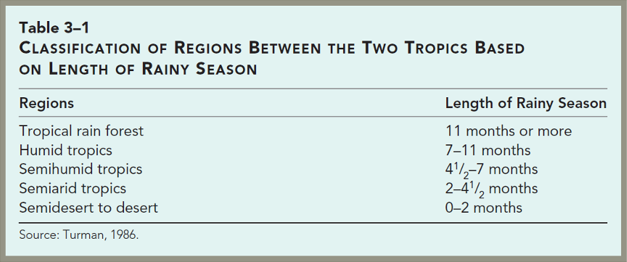
Climatic Environments of the World

Slide 19
Climatic Environments of the World
Deserts
Two major problems limit livestock production in the semiarid regions of the world. These problems are:
seasonal and limited rainfall;
and stress caused by the heat.
The semiarid tropics contain parasites and insects but not to the extent of the humid tropics.
Another problem in the drier areas of the world is high winds causing erosion in very dry, overgrazed areas and contributing to desertification.

Slide 20
Climatic Environments of the World
Cold Environments
In the world’s cold climates, livestock production is hampered by cold stress and food availability.
Temperate Climates
The world’s temperate environments are the most productive agricultural regions of the world.
All developed countries have a temperate climate in at least part of their boundary.

Slide 21
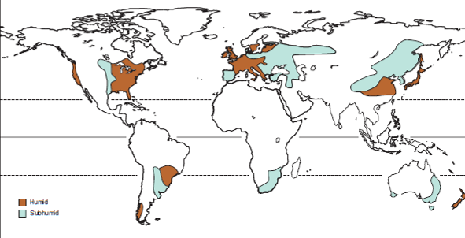
Climatic Environments of the World
Figure 3-13 Distribution of the temperate climates of the world. (Source: USDA, 1941 Yearbook of Agriculture.)

Slide 22
Social and Cultural Differences
Many social and cultural influences on agriculture are region and/or people specific.
They are also dynamic and evolving and influenced by the economic situation.
Social and cultural structures have tremendous influence on what specific people eat.
We rarely eat simply to satisfy hunger or fulfill nutritional needs.

Slide 23
Social and Cultural Differences
Religion
Effects of Religion on Agriculture
Three of the great religions of the world affect the numbers and utilization of livestock.
Islam forbids all contact with swine.
Judaism also considers pork unclean and forbids consumption.
Under Hinduism the cow is protected and can neither be slaughtered nor sold for slaughter.

Slide 24
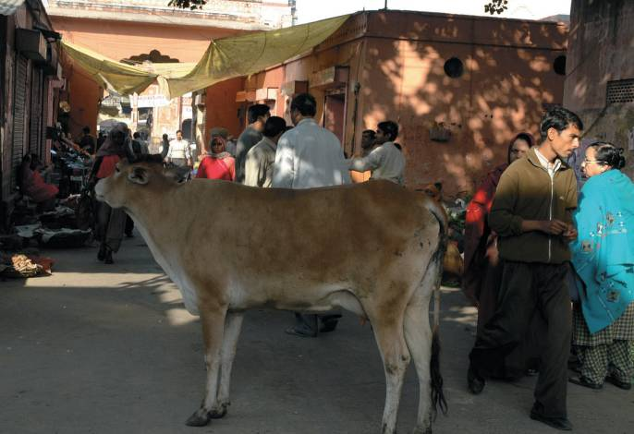
Social and Cultural Differences
Figure 3-16 The Hindu religion prohibits the slaughter of cattle, which results in a vast accumulation of cattle in India. (Photo courtesy of Paige Rabalais. Used with permission.)

Slide 25
Social and Cultural Differences
Religion
Food and Religion
Some religious law dictates selection and judgment of the quality of food before the gods will approve it.
Religious food laws frequently reflect a commonsense approach to the prevention of food contamination and foodborne disease.
For instance, kosher food inspection and certification were in place long before modern food inspection.

Slide 26
Social and Cultural Differences
Level of Economic Development
Two terms, developed countries and developing countries, refer to a country’s level of economic development.
Other terms in common use are First World, Second World, and Third World.
First World countries have a market economy.
Second World countries have a centrally planned economy.
Third World countries range from those that have a moderate standard of living to those with extreme poverty.

Slide 27
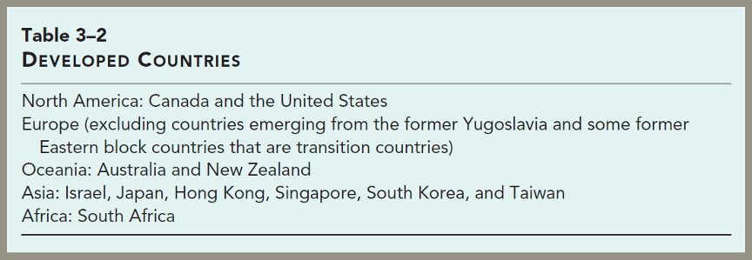
Social and Cultural Differences

Slide 28
Social and Cultural Differences
Levels of Agricultural Development
The three levels of agricultural development are developed, subsistence, and primitive.
The livestock systems in a developed agriculture are further subdivided.
Intensive systems are usually small, labor-intensive farm units.
Extensive systems are usually large range units.

Slide 29
Social and Cultural Differences
Levels of Agricultural Development
A developed agriculture is usually associated with:
A very small proportion (usually less than 10%) of the total population engaged in farming.
A highly specialized agriculture in which each unit producing only one or two products.
A highly mechanized agriculture with little or no animal or hand labor.
A high per capita income and literacy rate for the total population.

Slide 30
Social and Cultural Differences
Levels of Agricultural Development
Subsistence agriculture is usually associated with:
Approximately half of the total population engaged in farming.
Each farm family produces roughly what it consumes with only a small surplus for sale or barter.
Little mechanization and much hand and animal labor.
A relatively low per capita income and literacy rate for the entire population.

Slide 31
Social and Cultural Differences
Levels of Agricultural Development
Primitive agriculture is usually associated with:
Almost the entire population involved in producing their own food because no one produces a surplus.
Generally a scarcity of food and a low nutritional level.
No mechanization and very little animal power is used in farming.
Extremely low per capita income and literacy rate for the entire population.

Slide 32
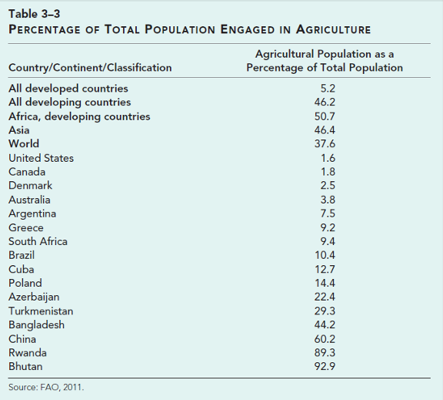
Social and Cultural Differences

Slide 33
Social and Cultural Differences
Economic Institutions and Agricultural Development
Financial Institutions
Financial institutions are a source of loans to finance agricultural enterprises and a place for the investment of profits from agriculture.
Marketing Agencies
Marketing agencies are essential to provide a means for people engaged in agriculture to sell their products at a satisfactory price and at a time when they want to sell.

Slide 34
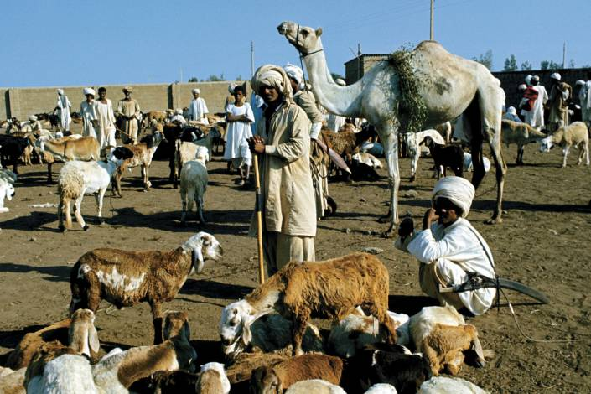
Social and Cultural Differences
Figure 3-17 In many developing countries, marketing agencies are nonexistent. Farmers are at the mercy of local traders who offer low prices. (FAO photo/7056/Photographer Franco Mattioli. Used with permission by the FAO of the U.N.)

Slide 35
Social and Cultural Differences
Economic Institutions and Agricultural Development
Industrial Institutions
Industrial institutions provide employment for the nonfarm population.
Wages paid to these workers provide a cash market for agricultural products.
They produce consumer goods needed in agriculture.
Governmental Agencies
These agencies are responsible for transportation (road building and maintenance), education, protection, equitable land policies, and sound money.

Slide 36
Summary and Conclusion
Agricultural animals must adapt to a wide variety of stresses if they are to be of uses to humans.
Our domestic animals and improved varieties of plants are influenced by a wide variety of factors, including cultural issues, economic development, and religion.
Levels of economic development and economic institutions influence the different levels of agricultural development.

