Slide 1
Introduction to Nutrition
Introduction to Animal Science:
Global, Biological, Social, and Industry Perspectives
W. Stephen Damron
Chapter 5

Slide 2
Learning Objectives
After studying this chapter, you should be able to:
define nutrition and understand the reason for studying nutrition.
explain what a nutrient is and know the difference between dietary essential and nonessential nutrients, classify the nutrients, and list the 50 dietary essential nutrients.
describe the general uses of nutrients in the body and discuss the major factors that affect an animal’s needs for nutrients.
explain in detail the three major types of animal trials that nutritionists use.
define and explain feedstuff analysis.
summarize the feeds evaluation procedures described in this chapter.

Slide 3
Introduction
The study of nutrition is important because:
Nutrition affects general health and well-being, physical abilities, and susceptibility to and ability to recover from disease.
Nutrition is also an intricate part of many body systems; if we understand nutrition, we can understand those systems.

Slide 4
Introduction
Nutrition is the study of how the body uses the nutrients in feed to sustain life and for productive purposes.
In commercial livestock production, it is important to study nutrition to be able to feed livestock cost effectively.
Depending on the type of enterprise, the cost of feed and feeding is 45-75% of the total cost of livestock production.

Slide 5
Introduction
The field of nutrition is broad and encompasses much information: nutritionists thus need to specialize.
Monogastric nutritionists focus on one-stomached animals such as poultry, swine, horses, dogs, cats, fish, rats, mice, monkeys, and some zoo animals.
Ruminant nutritionists specialize in animals that have a rumen such as sheep, goats, and beef/dairy cattle.
Most nutritionists tend to fall into one or the other of two additional camps: basic nutritionists or applied/production nutritionists.

Slide 6
Introduction
Basic nutritionists study the metabolism of the animals, and they are most interested in the biochemical mechanisms of nutrient metabolism.
Applied or production nutritionists are more interested in maximal, cost-effective feeding of animals in a production setting.

Slide 7
Nutrients and Their Uses
Nutrients are substances required for life processes.
They are used in body metabolism to maintain the body for reproduction, growth, and lactation.
Nutrients provide energy and building material for the body, as well as metabolic regulators.

Slide 8
Nutrients and Their Uses
Nutrients are classified as dietary essentials or dietary nonessentials.
Dietary essential nutrients must be part of the diet.
The nutrient classifications are:
water,
carbohydrates,
vitamins,
minerals,
proteins,
and fats (lipids).

Slide 9
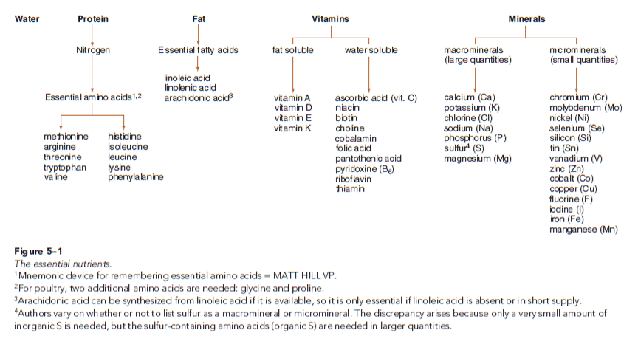
Nutrients and Their Uses

Slide 10
Nutrients and Their Uses
Water is frequently neglected in many discussions of nutrition.
This seems odd, considering that the body will die more quickly from water deprivation than from the deprivation of any other nutrient.
Water is used by the body as:
a lubricant;
a regulator of body temperature;
a solvent for the body’s solid components;
a transporting medium in body fluids,
and a necessary participant in chemical reactions.

Slide 11
Nutrients and Their Uses
Carbohydrates are sugars, starches, and cellulose; the primary use of carbohydrates is to provide animals with energy.
Grains are fed to livestock because their starch and sugar contents are easily digestible.
Cellulose is the major carbohydrate found in forages such as fresh pastures, silage, and hay.
Carbohydrates account for the largest single percentage of nutrient content in most commonly fed feedstuffs.

Slide 12
Nutrients and Their Uses
Proteins are compounds made up of long chains of amino acids; their primary uses are components of lean tissue, enzymes, hormones, and body metabolites.
Excess proteins in the diet are used for energy.
Animals need very different amounts of protein depending on the feeds used and the age and use of the particular animal.
Oilseed meals such as soybean meal and cottonseed meal are common protein feedstuffs.

Slide 13
Nutrients and Their Uses
Fats are esters of fatty acids and glycerol; they are used as a source of energy and essential fatty acids.
Fats are high in energy; on average, they have 2.25 times more energy than carbohydrates on an equal weight basis.
Fats are also important carriers for fat-soluble vitamins.
Common feedstuffs used for their fat content are tallow, lard, horse fat, and various vegetable oils.

Slide 14
Nutrients and Their Uses
Vitamins are organic compounds needed by the body in very small amounts. Many feeds are rich in vitamins, but some are very poor sources.
Vitamins are classified as:
fat-soluble vitamins which tend to be involved in regulating body functions such as vision, blood clotting, tissue maintenance, and growth such as bone development
or water-soluble vitamins that tend to be used more for body metabolic regulation.
Commercially prepared supplements are used in modern feed formulations and mixes.

Slide 15
Nutrients and Their Uses
Minerals are inorganic constituents of bones and teeth and an important part of the body’s enzyme systems.
Virtually all feedstuffs contain some minerals.
Supplemental minerals are provided in various forms including salt, trace mineralized salt, oyster shells, lime, and bone meal.

Slide 16
Nutrients and Their Uses
The nutritive value of feeds is quite variable.
Feeds must be selected to provide an appropriate diet for the purpose intended.
Some feeds are high in energy-furnishing nutrients and are used in finishing rations or producing milk and eggs.
When protein-rich feeds and vitamin and mineral mixes are added to the energy feeds, a ration of optimum production is born.

Slide 17
Body Functions and Nutrient Needs
Animals need nutrients to run the body’s metabolic machinery for maintenance, production, and reproduction.
The amount of nutrients depends on:
type of species, its digestive tract, and any peculiarities of its metabolism;
and the level of production and the product(s) being produced (work, fetus, growth, milk, eggs, and fiber).

Slide 18
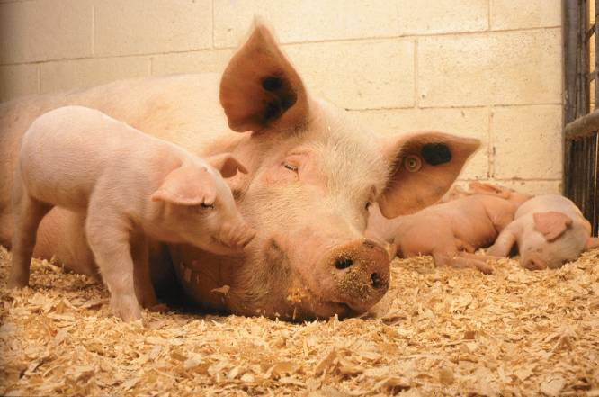
Body Functions and Nutrient Needs
Figure 5-2 Body functions dictate nutrient needs. Piglets need nutrients for growth, and sows need specific amounts for lactation. (Photo by Keith Weller. Courtesy USDA-Agricultural Research Service)

Slide 19
Body Functions and Nutrient Needs
Maintenance, in its simplest form, refers to maintaining the body at a constant weight and temperature.
The maintenance nutrient requirement is a combination of the nutrients needed for basal metabolism (activities such as heartbeat and breathing) and those for normal animal movement.
The maintenance needs must be met before the animal will produce any useful product.

Slide 20
Body Functions and Nutrient Needs
Growth is the process of increasing the body weight by adding tissue like that already present.
In growth, the body requires good-quality nutrients in relatively large amounts to build its structural units.
Nutrient needs are high in the growth phase and nutrient deficiencies become readily apparent.

Slide 21
Body Functions and Nutrient Needs
Finishing is the final growth and fattening phase of the production of meat animals.
All nutrients are needed for the finishing phase but some differences exist in this phase compared to growth phase.
Energy is needed during this phase in much higher proportions.
Less protein as a percentage of the total diet is needed during this phase than is needed for growth or production.

Slide 22
Body Functions and Nutrient Needs
Production refers to the output of products such as eggs, milk, and wool.
The nutrients needed for production vary with the product.
Work is a specialized production function and the major product of some species such as working horses, working dogs, and packing llamas.
The major nutrient increase needed for work is energy.

Slide 23
Body Functions and Nutrient Needs
Reproduction of live normal offspring is a basic biological necessity for a species to survive.
Providing adequate nutrition for the reproductive function must be accomplished in addition to maintenance and production.
Energy and protein must be increased, as well as several minerals and vitamins.

Slide 24
Feed Analysis
Properly feeding livestock requires knowledge of the nutrient found in the feedstuffs available and balancing of these nutrients to meet the physiological needs for the species in question.
A comprehensive evaluation procedure discovers nutrient composition, digestibility, productive value, palatability, and the physical or handling characteristics of feeds.

Slide 25
Feed Analysis
Three basis types of analytical methods are commonly used to analyze feeds for nutrient content.
Chemical procedures are standard chemistry applied to feeds.
Biological procedures use animals to test feeds; this is time consuming, labor intensive, and expensive.
Microbiological procedures are similar to biological procedures but use bacteria in place of higher animals.

Slide 26
Feed Analysis
Proximate analysis is a set of chemical/analytical procedures designed to partition feedstuffs into
water,
ash,
crude protein,
ether extract,
crude fiber,
and nitrogen-free extract.
This is the most common set of chemical tests used on feedstuffs.

Slide 27
Feed Analysis
Dry matter is determined by heating a feed sample until all water have evaporated; the percentage of sample that remains is referred to as dry matter.
To properly balance a diet and know how much of each ingredient to mix into a ration, the dry matter must be determined.

Slide 28
Feed Analysis
Ash is considered the mineral content of the feedstuff.
It is determined by burning a sample in a very hot oven (500-600°C) to burn off all the organic matter.
Crude protein (CP) is determined by the Kjeldahl process, which isolates and measures the nitrogen content of the feed.
Crude protein can then be calculated by multiplying total N by 6.25.

Slide 29
Feed Analysis
To determine ether extract (EE) (fat), a dry feed sample is extracted with diethyl ether.
The value of this test is to isolate the portion of the feed that has high-caloric density.
Carbohydrates (CHO) are not determined by direct analysis, but are measured in two fractions:
crude fiber (CF)
and nitrogen-free extract (NFE) or nonfiber carbohydrates.

Slide 30
Feed Analysis
The crude fiber (CF) procedure is an attempt to simulate digestion in the true stomach and the small intestine.
CF is made up of cellulose, hemicellulose, and insoluble lignin.
Nitrogen-free extract (NFE) is determined by subtracting water, ash, crude protein, fiber, and fat found in the feed from 100.
NFE should be the readily available carbohydrates, such as sugars and starches.

Slide 31
Feed Analysis
The Van Soest method is an alternative fiber analysis that was developed as a means of better describing forages in response to the limitations of proximate analysis.
This method can be used to predict the intake and digestibility of feedstuffs and is a means of evaluating heat damage to forages.

Slide 32
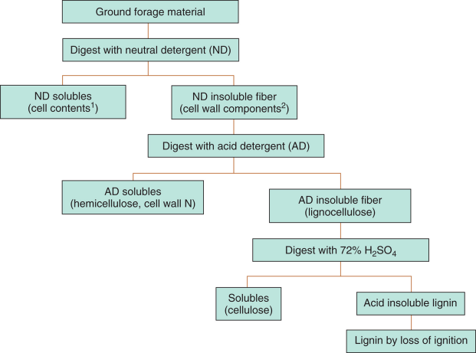
Feed Analysis
Figure 5-8 Flow diagram of the Van Soest fiber analysis. (Source: Jurgens, M.H. 1993, p. 58. Used with permission)

Slide 33
Feed Analysis
Vitamins must be assayed individually.
Biological assays are used for some; other are determined by chemical analysis.
The determination of energy content of common feedstuffs is a very important part of nutrition.
An instrument called a bomb calorimeter is used to determine the gross energy content of feedstuffs.
Gross energy is expressed in calories.

Slide 34
Feed Analysis
Determining the Value of Feedstuffs to Animals
Although chemical analysis of feed is important, it is only one step in determining the value of a feedstuff to animals.
To understand how feed affects the animal, we conduct three major types of animal trials:
feeding trials,
digestion trials,
and metabolism trials.

Slide 35
Feed Analysis
Determining the Value of Feedstuffs to Animals
A feeding trial is used to determine if animals will eat a feedstuff and how they will perform on it.
Common types of feeding trials include:
growth trials,
lactation trials,
egg production,
endurance (for horses),
or even measurement of some specified body function (sperm count, bone levels of calcium, etc.)

Slide 36
Feed Analysis
Determining the Value of Feedstuffs to Animals
Digestion trials are used specifically to discover the degree to which a feedstuff is digested and absorbed by the animal.
We feed a feedstuff with known nutrient makeup; feces are collected and analyzed to determine the nutrients that remain in it.
We then calculate a digestion coefficient by taking the difference in the nutrients fed and then excreted and calculate a percent disappearance.

Slide 37
Feed Analysis
Determining the Value of Feedstuffs to Animals
Metabolism trials are more advanced digestion trials that include measures of such things as urine and hair loss.
One type of metabolism trial is a balance trial.
The goal of a balance trial is to measure total intake and excretion so that retention in the animal’s body can be calculated.
Net retention of a nutrient within the body is positive balance and net loss is negative balance.

Slide 38
Feed Analysis
Determining the Value of Feedstuffs to Animals
The following formula is used to calculate digestion coefficients.
Nutrient intake – Nutrient in feces
X 100 = Nutrient digestibility (%)
Nutrient intake

Slide 39
Feed Analysis
Determining the Value of Feedstuffs to Animals
TDN (total digestible nutrients) is a measure that historically was used extensively to balance rations for livestock.
It is considered to be the digestible energy content of a feed.
TDN is calculated using digestion coefficients for crude protein, ether extract, crude fiber, and nitrogen free extract portions of a feed sample.

Slide 40
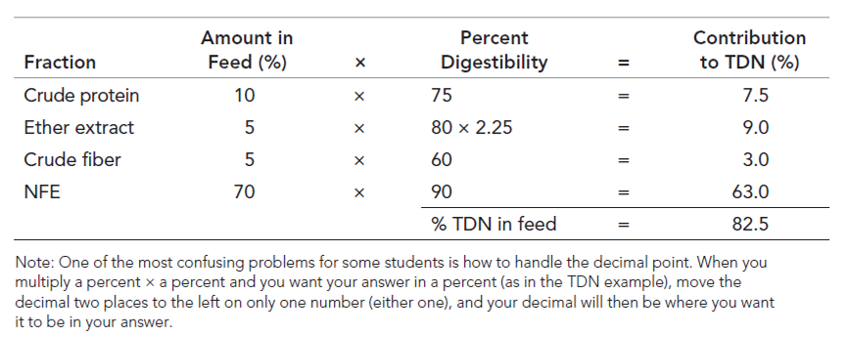
Feed Analysis
The basis procedure for calculating TDN is indicated by the following example:

Slide 41
Feed Analysis
Expressing Feed Composition on a Dry-Matter (DM) Basis
The nutrient contents of a feed are commonly expressed on either an air-dry (as-is) basis or a dry-matter basis.
To balance and feed rations, it is important to be able to convert them back and forth.

Slide 42
Feed Analysis
Expressing Feed Composition on a Dry-Matter (DM) Basis
The following equation demonstrates how to make the conversion.
Nutrient value on air dry basis
X 100 = Nutrient on a DM basis
Dry-matter content of feed

Slide 43
Feed Analysis
Measures of Energy
The units of energy most frequently used are:
Calorie (cal) = amount of heat/energy needed to raise 1 g of H₂O 1°C
Kilocalorie (kcal) = 1,000 calories
Megacalorie (mcal) = 1,000,000 calories
Uses of these units differs by species.
In human and pet nutrition, the term kilocalorie is used.
In livestock nutrition, Mcal are most frequently used.

Slide 44
Feed Analysis
The amount of energy lost from feed in the various compartments depends on several factors, including the kind of feed, its digestibility, and the animal.
These losses occur during digestion and metabolism and include heat of fermentation of the microbial population in ruminants and horses.

Slide 45
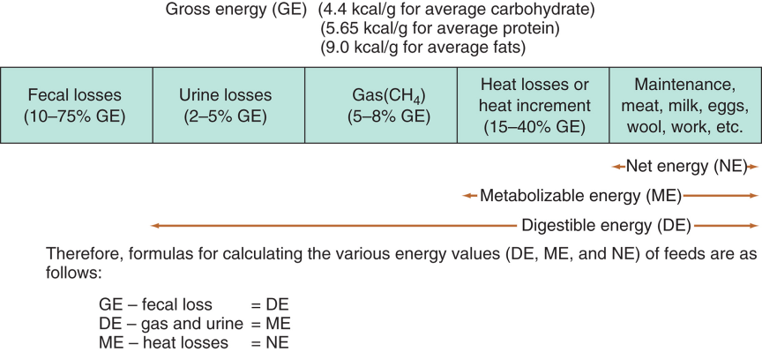
Feed Analysis
Figure 5-9 Schematic diagram for partitioning energy values of feeds. The numbers in parentheses represent range of the losses. (Source: Adapted from Wagner, 1977. Used with permission)

Slide 46
Feed Analysis
Energy Content of Nutrients
Carbohydrates, proteins, and fats all provide energy to the animal; however, their energy content (energy densities) are very different.
Carbohydrates have approximately 4 kcal/g.
Proteins have approximately 5.65 kcal/g, but about 1.65 kcal/g are lost in urine giving a net of 4 kcal/g.
Fats have approximately 9.0 kcal/g; it’s given a value that is 2.25 times greater than CHO and protein.

Slide 47
Feed Analysis
Efficiency of Energy Use
The purpose of all energy conversions in the body of animals is to convert energy into something useful, such as maintenance and/or products like meat, milk, work, wool, and eggs.
Metabolizable energy is used with different efficiency for various productive functions, some of which are more important in some species and not in others.

Slide 48
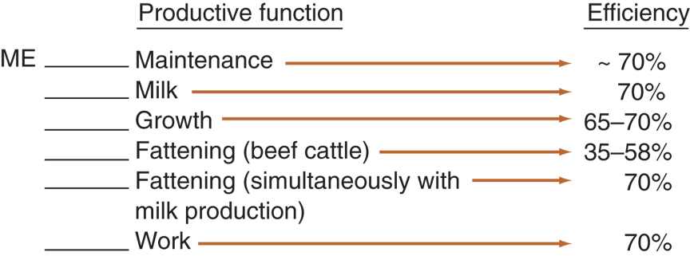
Feed Analysis
Figure 5-10 Efficiency of ME utilization.(Source: Wagner, 1977. Used with permission)

Slide 49
Feed Analysis
Efficiency of Energy Use
This is all related to TDN; the following formula is used to convert TDN to digestible energy (DE) and metabolizable energy (ME):
1 lb TDN = 2.0 Mcal DE or 1.7 Mcal ME

Slide 50
Feed Analysis
Nutrient Requirements
The outcome of all chemical tests and tall the animal trials has been the development of a set of nutrient requirements for the various species of animals commonly used in agriculture, research, and as companions.
The National Research Council, a branch of the National Academy of Science, publishes these nutrient requirements and recommendations for feeding animals in various stages of production.

Slide 51
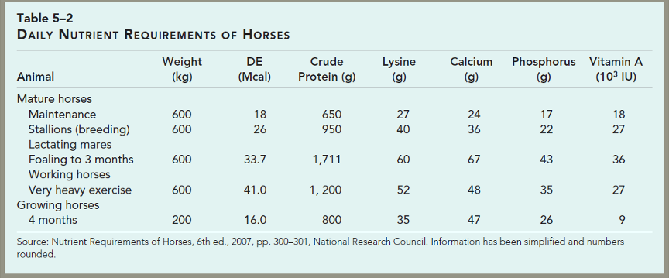
Feed Analysis

Slide 52
Feed Analysis
Ration Formulation
The amount of feed offered to an animal during a 24-hour period is called a ration.
A good balanced ration must be:
palatable;
free of damaging amounts of molds, disease, or other quality lowering factors;
economical;
and have no negative effects on animal health and well-being or product quality.

Slide 53
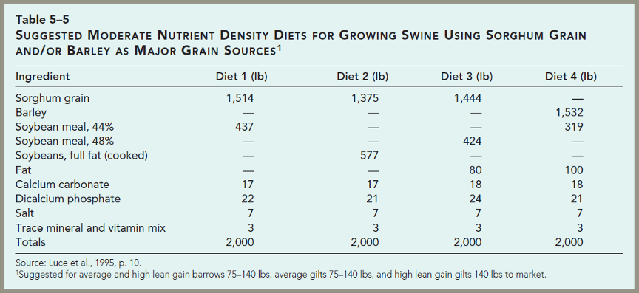
Feed Analysis

Slide 54
Summary and Conclusions
Nutrition is the study of how the body uses nutrients for maintenance and production.
Nutrients are the chemical entities that the body requires; we need to know how much of each is required for the animal we are feeding.
Feed contains nutrients; we must determine the amount of nutrients in a feed and how much the animal can actually use.
Knowing these things, we can balance a ration using ingredients to meet the animal’s needs.

