Slide 1
The Gastrointestinal Tract and Nutrition
Introduction to Animal Science:
Global, Biological, Social, and Industry Perspectives
W. Stephen Damron
Chapter 6

Slide 2
Learning Objectives
After studying this chapter, you should be able to:
describe the methods of the breakdown of food.
classify digestive systems according to the stomach type and type of diet consumed.
describe the steps of digestion.
identify the differences and similarities in the digestive process of animals.
explain the importance of the complex stomach of the ruminant and its benefits to the animal.

Slide 3
Introduction
Feeds and feedstuffs are chemically complex mixtures of substances that contain the nutrients an animal needs.
The digestive tract breaks down those complex materials to their constituent parts so the nutrients can be absorbed and metabolized by the body.
Breakdown of food by the digestive system in preparation for absorption is called digestion.

Slide 4
Introduction
Digestion is accomplished in three ways:
physical and mechanical actions (chewing and muscular contractions),
chemical action (hydrochloric acid and bile),
and the action of enzymes (produced by the animal or microorganisms), which increase the speed of breakdown of the chemical bonds in foods.

Slide 5
Introduction
Nutrient metabolism and metabolic pathways are essentially the same for different species, but they have different requirements, consume different feeds, and digest food very differently.
The type of digestive system an animal has dictates what the animal can successfully use as feed.

Slide 6
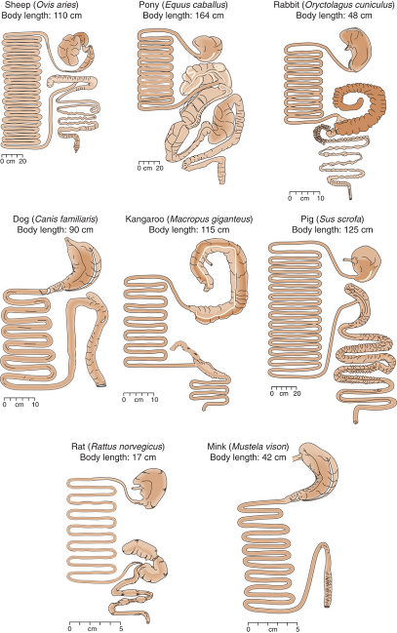
Figure 6-1 Mammalian digestive tracts. (Source: Swenson, 1984. Used with permission of the publisher, Cornell University Press.)

Slide 7
Classification of Digestive Systems
Monogastrics, or nonruminants, are one stomached, or simple-stomach animals.
The ruminants—cattle, sheep, goats, and pseudoruminants (llamas)—are more complex-stomached animals that have more than one stomach compartment.

Slide 8
An Overview of the Steps of Digestion
Prehension, the means an animal uses to bring food into its mouth, is the first step of digestion.
Mastication, or chewing, involves the action of the jaw and teeth to crush the food.
Salivation includes secretion and mixing of saliva with food.

Slide 9
An Overview of the Steps of Digestion
Swallowing, or deglutition, is the passing of food and water from the mouth to the first stomach compartment via the esophagus.
Significant chemical and enzymatic breakdown begins in the glandular (true) stomach.
Chemical digestion is provided by hydrochloric acid (HCl), which denatures proteins for degradation by the enzyme, pepsin.

Slide 10
An Overview of the Steps of Digestion
The small intestine is divided into three portions:
The duodenum extends from the pylorus of the stomach and is the main site of food breakdown.
The jejunum is the second and largest portion of the small intestine; its main function is for absorption of digestive end-products.
The ileum is the third part and functions to form the connection to the large intestine, but some absorption occurs here also.

Slide 11
An Overview of the Steps of Digestion
The large intestine contains no villi (unlike the small intestine); thus absorption is restricted.
The large intestine has three parts: the cecum, the colon, and the rectum.
Some digestive materials from the small intestine are absorbed—particularly water and electrolytes.

Slide 12
An Overview of the Steps of Digestion
Monogastric herbivores (horses, rabbits, guinea pigs, and elephants) have an extensive colon and functional cecum.
The large intestines and ceca of monogastric herbivores function much as the rumen does.
Microorganisms break down cellulose.
B-complex vitamins are produced.
Volatile fatty acids (VFAs) are produced, absorbed, and used as energy source.
A lot of bacterial protein is also manufactured.

Slide 13
An Overview of the Steps of Digestion
Defecation is the discharge of excrement from the body via the rectum or cloaca.
The quantity of feces is affected by how well the feed is digested.
Micturition is urination.
The components of urine include the nitrogen compounds—urea in mammals and uric acid in birds and other species.

Slide 14
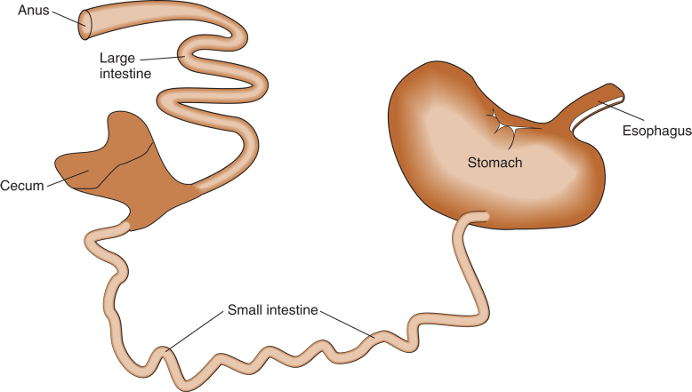
Digestion in the Pig
The pig is omnivorous and monogastric.
Figure 6-3 Swine digestive tract.

Slide 15
Digestion in the Pig
The pig is the only farm animal in which any amount of the enzyme salivary amylase is secreted in the saliva.
Amylase begins to breakdown starch in the feed.
However, this is of little nutritional importance because the feed does not stay in the mouth long.
The pH in the stomach is too low (acidic) for amylase to act on the starches.

Slide 16
Digestion in the Pig
The enzymes contained in the gastric juices of the pig are those expected in a monogastric animal.
Digestion of protein is completed in the intestine and most fat digestion occurs in the small intestine.

Slide 17
Digestion in the Pig
Pancreatic juice contains a number of enzymes that aid in digestion, as well as sodium carbonate and sodium bicarbonate, which neutralize acid from the stomach.
The pancreas also produces insulin, which plays an important role in carbohydrate metabolism.
Bile, formed in the liver, assists in the digestion and absorption of fats and aids in the absorption of fat-soluble vitamins.

Slide 18
Digestion in the Ruminant
The most important difference between ruminants and nonruminants is the complex stomach ruminants and the very different digestion that takes place there.
The main function of the complex stomach of the ruminant is to allow the animal to use roughage (cellulose) as a source of energy.

Slide 19
Digestion in the Ruminant
Microbial populations housed in the first three compartments ferment feed.
The end products of the fermentation process provide nutrients to the animal that would otherwise be unavailable for any productive use.

Slide 20
Digestion in the Ruminant
A ruminant typically fills the rumen rapidly, taking little or no time to chew its meal, and then finds a place to rest and chew.
During rumination, the animal regurgitates the food eaten earlier and spends time chewing it.
The more fiber in a diet, the more the animal will ruminate, and vice versa.

Slide 21
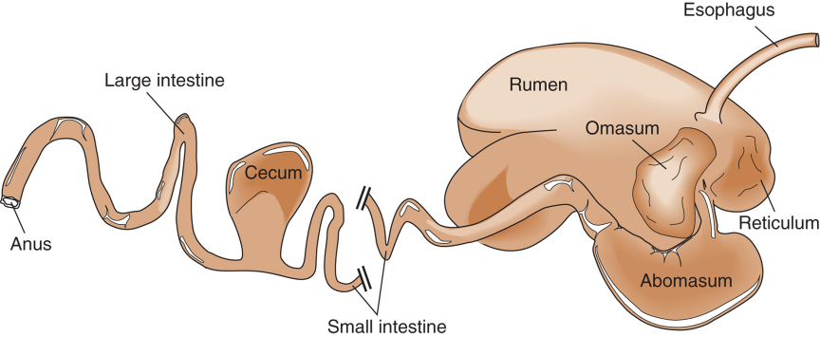
Digestion in the Ruminant
Anatomy of the typical ruminant stomach.
Figure 6-4 Digestive system of the ruminant.

Slide 22
Digestion in the Ruminant
The complex stomach is comprised of four compartments:
rumen,
reticulum,
omasum,
and the abomasum.
The first three of these are collectively known as the forestomachs; the lining of these is nonglandular and does not produce mucus or enzymes.

Slide 23
Digestion in the Ruminant
The abomasum, or true stomach, is lined with mucous membrane, and gastric juice is secreted, as in the stomachs of all mammals.
Generally speaking, from the abomasum to the anus, the ruminant tract is much the same as a monogastric tract.

Slide 24
Digestion in the Ruminant
The main function of the rumen is to act as a site of anaerobic bacterial fermentation.
The rumens also functions to store food until the animal has time to chew it into smaller particles.
The bacteria in the rumen digest carbohydrates (cellulose, starch, and so on) and other plant material and produce volatile fatty acids (VFAs).

Slide 25
Digestion in the Ruminant
A major benefit of microbial fermentation is the protein manufactured by the microorganisms.
Bacteria can even convert non-protein nitrogen (NPN) such as urea into bacterial protein, which the animal subsequently uses.
The bacteria pass out of the rumen and down the tract with the feed and are digested in the abomasum and small intestine.

Slide 26
Digestion in the Ruminant
The bacteria also contain energy, vitamin K, and water-soluble vitamins that the animal is able to digest, absorb, and use.
The microorganisms do not synthesize vitamin A, D, and E.
The bacteria also produce essential fatty acids for the animals.

Slide 27
Digestion in the Ruminant
The reticulum acts as the pacemaker of rumen contractions.
These contractions function to mix the rumen contents and move the contents through the digestive tract.
The omasum absorbs water, electrolytes, and VFAs and reduces particle size of the feed before it enters the abomasum.

Slide 28
Digestion in the Ruminant
Eructation is a very important mechanism for ruminants.
The large quantities of gas produced by the rumen microorganisms as a by-product of fermentation must be removed.
The gas belched out of the rumen enters the lungs and is breathed out, muffling the sound.

Slide 29
Digestion in the Ruminant
The Fermentation Process
Rumen microorganisms and the ruminant animal live in symbiosis.
The animal benefits because the microorganisms digest feeds it could not otherwise use and generate nutrients it needs.
The ruminal environment provides near ideal living conditions for the microorganisms including
warmth,
moisture,
food supply,
—removal of end products of digestion,
—darkness,
—and an aerobic environment.

Slide 30
Digestion in the Ruminant
The Fermentation Process
Many different bacteria are found in the rumen and include populations that specialize in
digesting specific carbohydrates (cellulose, hemicellulose, starch, sugars), proteins, and acids.
Other bacteria produce ammonia, vitamins, and methane.
Nearly 40 species of ciliate protozoa also occupy the rumen.
Protozoa use the same substrates as the bacteria an dine on the bacteria as well.

Slide 31
Digestion in the Ruminant
The Fermentation Process
Virtually everything the ruminant eats is affected by the rumen fermentation.
VFAs are the major product of ruminal fermentation; these include:
acetate, propionate, butyrate, isobutyrate, valerate, and isovalerat.
VFAs may provide as much as 50-70% of the total energy needs of the animal.

Slide 32
Digestion in the Ruminant
The Fermentation Process
Much of the protein is broken down by microorganisms to ammonia and organic acids.
Microorganisms use the ammonia to manufacture amino acids for their own use; NPN sources can also be used.
High levels of fat are bad for the microbes and reduce their overall ability to function.
Gas and heat are other products of fermentation; this heat can be used to warm the animal in winter.

Slide 33
Digestion in the Ruminant
Advantages and Disadvantages of the Ruminant System
Advantages:
Fermentation has the potential to digest poor quality feeds and increase their feeding value.
Essential nutrients not found in the animal’s diet (vitamins, amino acids, and fatty acids) are made by the microbes and used by the animal.
Disadvantages:
Fermentation has the potential to decrease the overall quality in high quality feeds.
The fermentation process also requires and wastes a considerable quantity of energy.

Slide 34
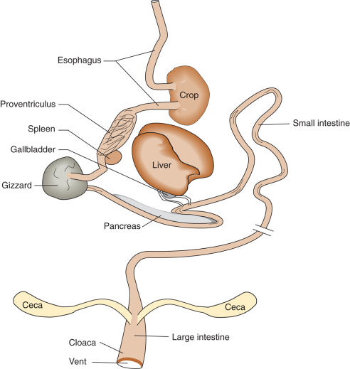
Digestion in the Avian
Figure 6-47
Digestive system of the avian.

Slide 35
Digestion in the Avian
The digestive organs of fowl are similar to those of other monogastrics except for the lack of teeth and the presence of the gizzard and the crop.
The crop is a dilation of the esophagus.
It functions for food storage and moistening.
Fermentation occurs in the crop in some species.

Slide 36
Digestion in the Avian
The proventriculus is equivalent to the glandular stomach in mammals or the abomasum in ruminants.
This is the site of gastric juice production (HCl and pepsin) and has a pH of 4.
Ingesta passes through in a matter of seconds, so virtually no digestion takes place.

Slide 37
Digestion in the Avian
The gizzard, or ventriculus, is a highly specialized grinding organ and is very muscular.
In free-ranging birds, the gizzard contains grit to aid in the grinding of feed to smaller particles; however, with modern preground rations, grit is unnecessary.
No enzymes are secreted, but the enzymes form the proventriculus work here.

Slide 38
Digestion in the Avian
The small intestine functions in digestion and absorption of feed and nutrients just as in other monogastrics.
The first part of the small intestine is the duodenum just as in other animals, but there is no specifically separated jejunum or ileum like that of mammals.

Slide 39
Digestion in the Avian
There are two ceca located at the junction of the small and large intestine.
The size is influenced by the type of diet—the ceca are larger when the animals consumes high fiber.
The modern chicken is fed little fiber and therefore does not make use of its ceca.

Slide 40
Digestion in the Avian
The large intestine is relatively short in birds; it is not divided into a distinct rectum or colon as it is in mammals.
The cloaca is the common orifice for waste elimination (feces and urine), copulation, and egg laying in the females.

Slide 41
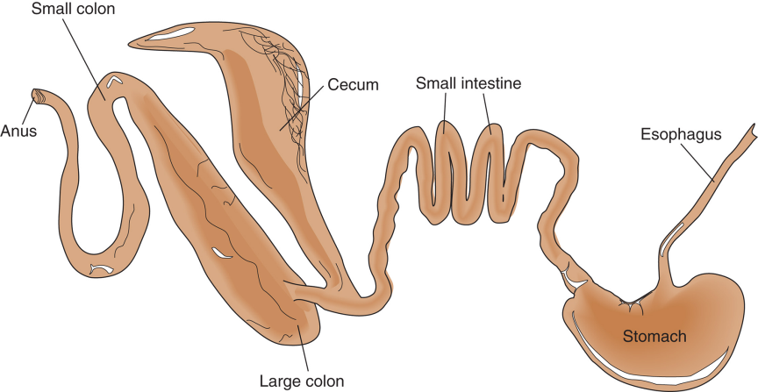
Digestion in the Horse
Figure 6-8 Digestive system of the horse.

Slide 42
Digestion in the Horse
The horse is a nonruminant herbivore; it is capable of using roughage because is has an active cecal bacteria population that digests fiber.
The horse accomplishes prehension with its teeth, flexible upper lip, and tongue.
The saliva of horses contains no enzymes, but is an important lubricant for the coarse material the horse eats.

Slide 43
Digestion in the Horse
The stomach of the horse has some important distinctions compared to the stomachs of other mammals.
The most distinctive difference is that the stomach capacity is smaller.
The horse stomach is also unique in that it does not have equivalent muscular activity to that of other species.
These two factors result in the horse being more susceptible to stomach disorders like colic and rupture stomachs.

Slide 44
Digestion in the Horse
The small intestine of the horse is similar to that of other monogastrics except for the absence of a gallbladder.
The horse evolved as a continuous eater and had no need for storage of bile to help with digestion of food consumed in meals.
The large intestine of the horse is divided into the cecum, large colon, small colon, and rectum.
It accounts for over 60% of the total gut capacity.

Slide 45
Digestion in the Horse
The cecum and large colon contain a bacterial population similar to that of ruminants.
Bacterial fermentation produces VFAs similar to those of the ruminant, which are absorbed and used by the animal.
The horse on a forage diet receives the majority of its energy in the form of these VFAs.
Bacteria also produce water-soluble vitamins.

Slide 46
Digestion in the Horse
Bacterial synthesis of protein occurs, but the horse is not able to absorb this product.
Because this protein is not subject to action of the digestive juices, the horse benefits little from it unless it practices coprophagy which does occur in horses in a poor diet.

Slide 47
Digestion in the Horse
The soluble carbohydrates are digested and absorbed in the small intestine much as in any monogastric.
The fiber fractions are fermented in the large intestine and colon.
The horse is only about two-thirds as effective at fiber digestion as the ruminant.

Slide 48
Summary and Conclusion
Different species have very different digestive tracts.
These differences are both anatomical and functional and in many ways dictate how the animals must be fed.
The overall goal of digestion is the same for all species: to release nutrients for the animal to absorb and metabolize in order to maintain and produce.

