Slide 1
Genetics
Introduction to Animal Science:
Global, Biological, Social, and Industry Perspectives
W. Stephen Damron
Chapter 8

Slide 2
Learning Objectives
After studying this chapter, you should be able to:
explain the role that genetics plays in animal production.
describe the location of genes within a cell.
explain the process of cellular division that ultimately produces cells containing only half of the genetic information.
describe how variation in traits is passed from parent to offspring.
describe how gene frequencies change within a population.
explain the concept of relationship between individuals.
describe several systems of mating individuals.
summarize the implications of genetic engineering.

Slide 3
Introduction
Genetics can be termed the foundation of life, for without the ability to transfer genetic information from one generation to the next, existence would be impossible.
An animal’s genetic makeup, or genotype, sets the stage for disposition, coat type, coat color, speed, gait types, body composition, growth, reproduction, milk production, disease resistance, and other traits.

Slide 4
Introduction
The expression of the genotype into traits of economic importance provides the basis for the animal’s worth when marketed.
From a livestock producer standpoint, efficiency of production might be the most important overall goal.
However, from a consumer’s position, tenderness, flavor, color, and leanness might top the list of important characteristics.

Slide 5
Introduction
Applied genetics in animals is usually referred to as animal breeding.
It is the science that helps in the quest to breed better animals and has led to remarkable changes in animal species.
Research in genetic engineering has made possible advances that may come to dwarf earlier accomplishments.

Slide 6
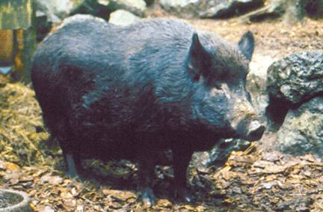
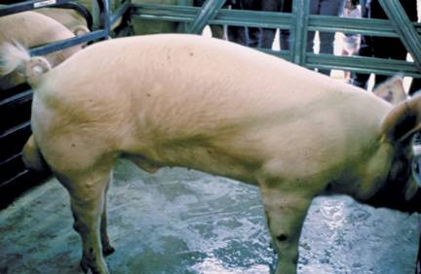
Introduction
(a)
(b)
Figure 8-1The application of animal breeding and selection techniques has led to remarkable changes, such as arranging the genes of the wild boar (a)into those of the modern meat-type hog (b).

Slide 7
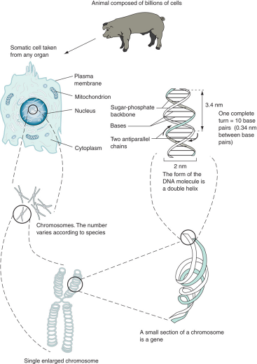
The Gene
Figure 8-1 Location and structure of genetic material.
The nucleus of the cell contains the chromosomes, which are made up of DNA and protein and found in pairs.
Within these large molecules are smaller segments of DNA called genes.
It is the arrangement of genes, DNA, and chromosomes that provide the basis for inheritance.

Slide 8
The Gene
Deoxyribonucleic acid (DNA) consists of two strands comprised of alternating sequences of the sugar deoxyribose and phosphate bonds.
At each sugar, there is bridge of nitrogen bases composed of chemical compounds called purines and pyrimidines.
The purines are adenine (A) and guanine (G).
The pyrimidines are thymine (T) and cytosine (C).
The bridges are always combined, with adenine attaching to thymine and guanine with cytosine.

Slide 9
The Gene
Figure 8-1Chemical nature of DNA. This structure is the double helix form of DNA. A & T are joined with double hydrogen bonds; G & C are joined with triple hydrogen bonds.

Slide 10
The Gene
The segment of the deoxyribose, phosphate, and one of the bases is called a nucleotide.
A gene is a segment of the double helix consisting of several nucleotides which encode the specific composition of proteins.
The entire genetic material of an animal is termed its genome.

Slide 11
The Gene
There is some potential for variation in chromosome numbers because of the many processes that must take place for inheritance to be possible.
One such variation in chromosome numbers is called polyploidy.
Another example of variation is aneuploidy, in which there is variation in chromosome number with respect to individual chromosomes.

Slide 12
The Gene
DNA replication is the process of making a copy of a DNA molecule.
This process of synthesizing DNA is carried out by unzipping the existing DNA strand between base pairs to expose each base.
The process of polymerization is carried out by DNA polymerase.

Slide 13
The Gene
DNA serves as a template and codes for the manufacture of RNA to complement the DNA.
This process is known as transcription.
This new RNA is processed to remove sections of base pairs that are not part of the coding sequence; this is called messenger RNA (mRNA).
The DNA also codes for transfer RNA (tRNA), which is used to collect the amino acids needed to build the protein.

Slide 14
The Gene
The mRNA leaves the nucleus and attaches to the ribosome, where it is used as the template to manufacture the protein.
The tRNA moves into the cytoplasm and attaches to the amino acid for which each is coded.
Next, the ribosomes move along the length of the mRNA and align with the tRNA, which brings the amino acids into the chain.
This process is called translation.

Slide 15
Principles of Inheritance
In 1866, Gregor Mendel discovered the principles of inheritance while working with garden peas.
Our understanding of how traits are inherited has sprung from the simple experiments of this monk.

Slide 16
Principles of Inheritance
The various forms of a given gene are called alleles.
An animal that has matching alleles at a given point on the chromosome (or locus) is said to be homozygous (AA).
An animal that has different alleles is heterozygous (Aa).
Chromosomes that have the same size and shape and occur in pairs are called homologous chromosomes.

Slide 17
Principles of Inheritance
The method by which these alleles are passed on from one generation to the next is known as inheritance.
Each parent produces reproductive cells called gametes.
In the formation of these gametes, the parental alleles separate so that each gamete contains only half of the genetic code the parent possesses.

Slide 18
Principles of Inheritance
Two important principles come into play at this point:
The principle of segregation states that alleles separate so that only one (randomly chosen) is found in any particular gamete.
The principle of independent assortment states that in the formation of gametes, separation of a pair of genes is independent of the separation of other pairs.

Slide 19
Principles of Inheritance
The concept of sex determination is important in the formation of gametes; the male gametes are sperm and the female gametes are eggs.
In mammals, female genotypes contain a pair of X chromosomes and males have an X and a Y chromosome;
The opposite is true in avian species.

Slide 20
Principles of Inheritance
Each normal body tissue cell, or somatic cell, of an individual has two sex chromosomes, or one pair.
However, every somatic cell also has autosomes, which are simply all chromosomes other than sex chromosomes.
A visual representation of the chromosomes of a species is called a karyotype.

Slide 21
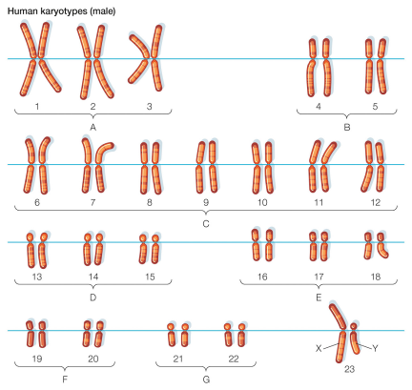
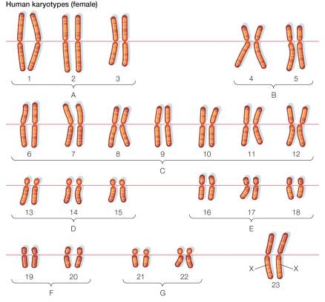
Principles of Inheritance
Figure 8-4 A false-color light micrograph of a normal human karyotype.

Slide 22
Principles of Inheritance
Chromosomes occur in pairs in somatic cells.
Thus a somatic cell contains a diploid (2n) number of chromosomes.
The germ cells, sperm and egg, contain only a haploid number (n).
Another feature of the chromosome is the centromere, which can be located anywhere along the chromosome.
The centromere serves as the point of attachment for the spindle fibers during cell division.

Slide 23
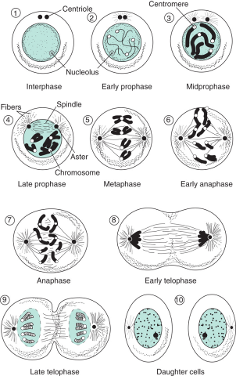
Mitosis and Meiosis
Mitosis
Mitosis is the process of somatic cell division;
It is really just replication of cells.
A diploid cell undergoes division that allows the production of two diploid (2n) cells.
Figure 8-5 Mitosis.
(Source: Levine, 1980. Used with permission)

Slide 24
Mitosis and Meiosis
Meiosis
Gametogenesis is the development of the sex cells, (i.e., sperm and oocyte).
This is a reductional process (2n to n) responsible for forming cells that contain half of the genetic message.
The cell division that occurs in gametogenesis is called meiosis.

Slide 25
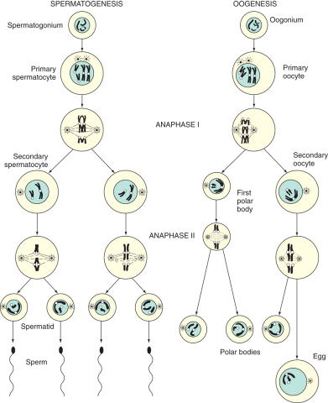
Mitosis and Meiosis
Meiosis
Meiosis consists of two divisional procedures.
During the first division, one diploid cell (2n) divides into two haploid cells (n).
The second division consists of a replication of each of the two haploid cells to produce four haploids.
Figure 8-6 Meiosis.
(Source: Levine, 1980. Used with permission)

Slide 26
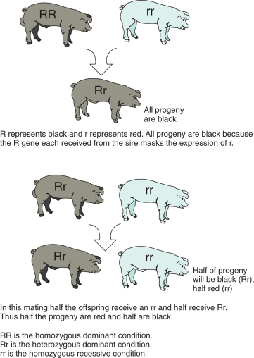
Gene Expression
Dominant and Recessive Expression
A dominant allele is one member of a gene pair is expressed to the exclusion of the other.
A recessive allele is the member of a gene pair that is only expressed when the dominant allele is absent from the animal’s genome.
Figure 8-7 The behavior of simple dominant and recessive genes.

Slide 27
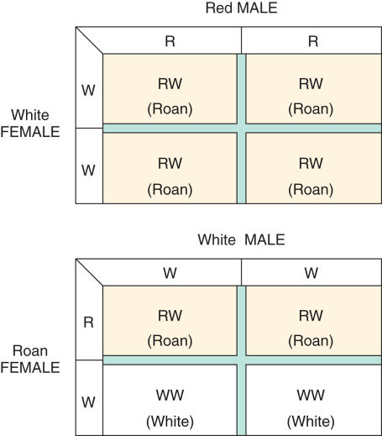
Gene Expression
Codominance occurs when neither allele masks the other and both are expressed in the phenotype.
Incomplete dominance occurs when no dominance exists and a heterozygous individual will appear as an intermediate between the two alleles.
Figure 8-8 Codominance.

Slide 28
Gene Expression
Epistasis
Many gene pairs act in concert with one another to produce gene expression; this is known as epistasis.
Multiple Alleles
Remember that only two alleles can exist on each locus for an individual; however, there could be many alleles of a gene present in a population.
This is known as a system of multiple alleles.

Slide 29
Gene Expression
Testcrossing
It is not possible to look at an animal and determine its genotype based on its phenotypic appearance when dominance is in effect.
An animal could be heterozygous or homozygous dominant, either of which will express the dominant phenotype.
A testcross can determine whether the animal is homozygous or heterozygous by mating that animal with one with a homozygous recessive genotype.

Slide 30
Sex-Related Inheritance
Sex-Linked Inheritance
Some genes are located only on the X or Y chromosome and therefore are inherited only when that respective chromosome is passed on; this is referred to as sex-linked inheritance.
X-linked genes can be passed on to either male or female offspring because each has at least one X chromosome.
Y-linked genes are inherited only with that chromosome, meaning only males can have a phenotype representative of that gene.

Slide 31
Sex-Related Inheritance
Sex-Influenced Inheritance
The genes for sex-influenced inheritance traits are carried on the autosomes; the phenotypes are not expressed in the same way in the two sexes.
An example is horns in sheep.
Sex-Limited Traits
In sex-limited traits, traits are unique to only one sex; both sexes carry genes for these traits, but only one sex is capable of expression.
Some examples are milk production, litter size, and egg production by females.

Slide 32
Population Genetics
Gene Frequency
Gene frequency is defined as the proportion of loci in a population that contain a particular allele.
Thus the genotypic frequency can be defined as how often a particular genotype occurs in a population.
The proportion of individuals in a population that express a particular phenotype is the phenotypic frequency.

Slide 33
Population Genetics
Animal Breeding and Population Genetics
The study of how gene and genotypic frequencies change, and thus change genetic merit in a population, is called population genetics.
The science of using the principles of genetics to make improvement in a livestock species is animal breeding.
Robert Bakewell is given credit for being the first animal breeder; he began in the 18th century.

Slide 34
Population Genetics
Mutation and Genetic Drift
Mutations are changes in the chemical composition of a gene that alter DNA.
This causes the production of new alleles that can affect gene and genotypic frequencies.
Another method by which gene frequencies change is genetic drift.
This is a change in gene frequency owing to chance.

Slide 35
Population Genetics
Migration and Selection
Migration is the process of bringing new breeding stock into a population.
Selection is the process of allowing some animals to be parents more than others; two types of selection can occur.
Natural selection is based on the fact that some animals are more suited and/or have more natural opportunity to be parents than are others.
Artificial selection is based on management decisions to allow certain animals more opportunity to mate and produce offspring than others.

Slide 36
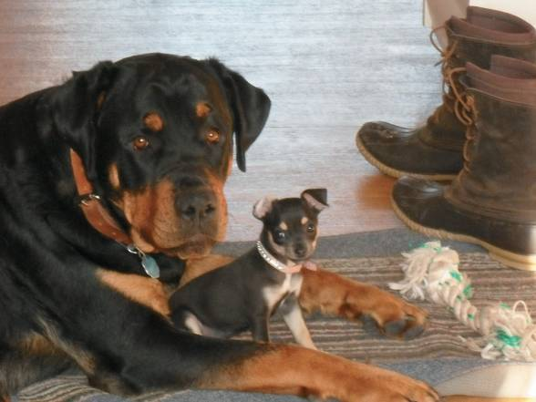
Population Genetics
Figure 8-9 Through artificial selection, animals within a species have been developed into breeds as diverse as the Rottweiler and the Chihuahua. (Photos courtesy of Christy Collins, Inc. Used with permission.)

Slide 37
Quantity versus Quality Traits
Qualitative and Quantitative Traits
Qualitative traits are those for which phenotypes can be classified into groups rather than numerically measured.
Quantitative traits are those that are numerically measured and usually controlled by many genes, each having a small effect.

Slide 38
Quantity versus Quality Traits
Qualitative and Quantitive Traits
If there is no dominance at a locus, it is referred to as additive gene action.
This is when the total phenotypic effect is the sum of the individual effects of the alleles.
The environment in which the animal is raised also has an effect on the expression of quantitative traits.
The phenotype is a result of the genotype and environmental interaction.

Slide 39
Quantity versus Quality Traits
Heritability
Differences in the phenotypes of animals are due to genetics and environment.
Practically speaking, heritability is a measure of the proportion of phenotypic variation that can be passed from parent to offspring.
The range of values for heritabilities is from zero to one, and they can be thought of as percentages or proportions.

Slide 40
Quantity versus Quality Traits
Heritability
As a rule, carcass merit traits are considered to be highly heritable (0.4–0.6).
Moderately heritable traits (e.g., growth traits) are those having heritabilities of 0.2–0.4.
Traits such as reproductive ability have low heritabilities (0–0.2).

Slide 41
Quantity versus Quality Traits
Heritability
The relationship between two animals can be thought of as the proportion of genes they are expected to have in common.
Siblings or offspring that have at least one parent in common inherit some of their genes from that parent, and thus have some of those gene pairs in common.
The relationship coefficient can range from 0–1 and is most often by a factor of half.

Slide 42
Quantity versus Quality Traits
The following is a list of common relationships and indicates how closely related the individuals are.
 | R
Full sibs | 0.5
Half sibs | 0.25
Parent-offspring | 0.5
Grandparent-offspring | 0.25
Great-grandparent | 0.125
Great-great-grandparent | 0.0625
First cousin | 0.125

Slide 43
Quantity versus Quality Traits
Systems of Mating
Inbreeding is the mating of closely related individuals.
It is used to increase homozygosity for desired traits and decreases the variation in the genes existing in a herd or population.
Detrimental recessive genes also begin to express themselves because of the increase in homozygosity.
It is important to avoid high levels of inbreeding so that expression of bad recessive genes can be minimized.

Slide 44
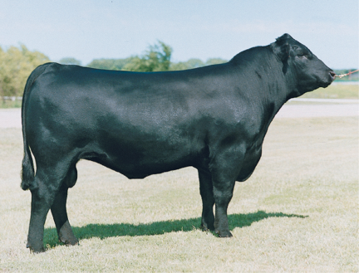
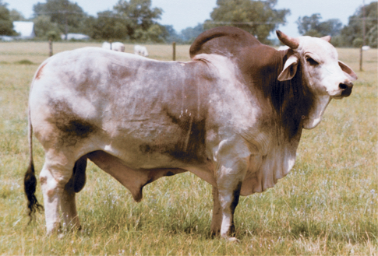
Quantity versus Quality Traits
Figure 8-10 Historically, inbreeding has been practiced to fix the traits associated with breeds such as color and markings, horns, and production traits to produce animals with distinctive characteristics. Compare these distinctly different beef breeds: the Angus and the Brahman. (Photos courtesy of Christy Collins, Inc. Used with permission.)

Slide 45
Quantity versus Quality Traits
Systems of Mating
Linebreeding is a form of inbreeding in which the purpose is to concentrate the genes of an outstanding ancestor in the linebred individuals.
Linebreeding may result in mild inbreeding if the common ancestor appears at least three to four generations back in the pedigree.
The adoption of modern genetic evaluations has replaced the practice of linebreeding in the livestock species.

Slide 46
Quantity versus Quality Traits
Systems of Mating
Outbreeding is the process of mating less closely related individuals when compared to the average of the population.
This procedure produces individuals that have more heterozygous gene pairs.
This increase in heterozygosity increases the vigor in the animals, which is termed heterosis, or hybrid vigor.

Slide 47
Quantity versus Quality Traits
Systems of Mating
Crossbreeding, mating animals from different breeds, is a means of taking advantage of outbreeding.
The success of a crossbreeding program depends on the quality of the animals used in the system and whether or not their genetics complement each other.
In general, crossbred individuals tend to be more vigorous, fertile, and healthy, and grow faster than the average of parental stock that make up the cross.

Slide 48
Biotechnology and Genetic Engineering
Genetics is an area of science that is contributing greatly to the overall advancements being made in biotechnology.
Molecular biology has made it possible to identify the specific genes that control various characteristics.
Worldwide, scientists are working to identify all of the genes of humans and animals, as well as their actual DNA sequences.

Slide 49
Biotechnology and Genetic Engineering
Once genes are located on the chromosome and the functions they control are identified, then more precise animal breeding practices can be employed.
Although conventional selection on performance characteristics would still be used, it could be enhanced through the inclusion of genetic markers obtained through DNA analysis.
This is referred to as marker-assisted selection.

Slide 50
Biotechnology and Genetic Engineering
In addition, inserting the genes from one animal into another can create new combinations of genes.
This can even be done between species.
This process of genetic modification creates a transgenic animal.

Slide 51
Biotechnology and Genetic Engineering
The benefits of this new form of genetic manipulation over conventional forms are multiple.
By using marker-assisted selection or transgenic animals, the outcomes of breeding practices will be easier to predict.
In traditional breeding practices, many of the genes passed to the next generation are unknown.
The speed of genetic improvement will be increased because the genetics of a set of potential breeding animals can be mapped long before they even reach puberty.

Slide 52
Biotechnology and Genetic Engineering
The area of greatest promise for gene manipulation and recombinant DNA technology is in a slightly different area.
Genes can be inserted from animals of the same or other species.
Animals, microorganisms,and plants can be genetically manipulated to produce substances they otherwise could not produce.

Slide 53
Biotechnolology and Genetic Engineering
These biotechnologies will provide benefits in other areas as well.
Specific gene therapies will be developed for diseases in animals and humans.
Animals can be transgenically altered to produce organs that do not trigger rejection reactions for transplant into humans.
Animals will be selected through the use of mapping technology to be resistant to specific diseases.

Slide 54
Summary and Conclusion
Genetics is the study of how DNA codes for the biochemical reactions of life.
Cells in the body reproduce by two processes: mitosis and meiosis.
Modern animal-breeding techniques have led us to organized efforts that help us manipulate the genetic code.
The tools of modern molecular biology are revolutionizing the science of genetics.

