Slide 1
Biotechnology and Genetic Engineering
Introduction to Animal Science:
Global, Biological, Social, and Industry Perspectives
W. Stephen Damron
Chapter 10

Slide 2
Learning Objectives
After studying this chapter, you should be able to:
describe the magnitude of the biotechnology industry in the United States.
define biotechnology and explain how genetic engineering is a part of biotechnology.
describe the recombinant DNA technology.
describe current and future uses of genetic engineering as it applies to field crop, food crop, and livestock production.
describe developing uses of rDNA organisms.
explain the regulatory mechanism in place to control genetically engineered organisms.
identify some of society’s concerns about genetic engineering.

Slide 3
Introduction
Biotechnology is the development of products by a biological process.
A variety of biological processes are used, ranging from traditional fermentation using yeast to modern transgenic mammals.
The products of biotechnology may be used in disease research, food production, waste management, or a myriad of other areas of need.

Slide 4
Introduction
The modern era of biotechnology began in 1953, when James Watson and Francis Crick proposed the double-helix structure of DNA.
New biotechnology owes its existence to the understanding of the cell and its components, and especially the genetic code.

Slide 5
Nuts and Bolts of Genetic Engineering
Recombinant DNA technology is the combination of DNA molecules from different biological sources.
Genetic engineering often relies on recombinant DNA technology and gene cloning to modify an organism’s genome.
Recombinant DNA is the core of biotechnology.

Slide 6
Nuts and Bolts of Genetic Engineering
Restriction Enzymes
The discovery of two essential components, restriction enzymes and plasmid DNA, made gene cloning and DNA recombinant techniques possible.
Restrictions enzymes are DNA-cutting enzymes, and plasmid DNA is a circular form of self-replicating DNA that scientists can manipulate to carry and clone other pieces of DNA.

Slide 7
Nuts and Bolts of Genetic Engineering
Restriction Enzymes
In order to transfer a gene, or a piece of DNA, it must be excised from the chromosome which is enable by the activity restriction enzymes.
Restriction enzymes are found primarily in bacteria where they play a defensive role against invading bacteriophage (a virus that attacks bacteria) by cutting the viral DNA into small fragments.

Slide 8
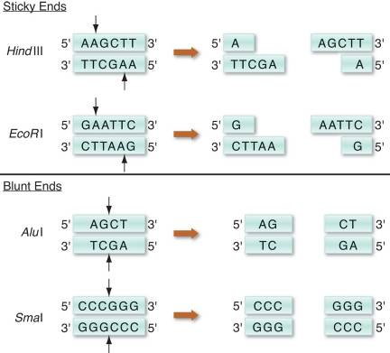
Nuts and Bolts of Engineering
Restriction Enzymes
These enzymes cut DNA only at a specific site called a restriction site.
They may produce blunt ends or sticky ends that are able to recombine with any complementary DNA molecule.
Figure 10-2 Selected restriction enzymes and their specific recognition
sites.

Slide 9
Nuts and Bolts of Genetic Engineering
Gene Cloning
Cloning in biotechnology refers to the process of creating copies of
DNA fragments (molecular cloning),
cells (cell cloning),
or whole organisms.
Cloning is frequently used to amplify DNA fragments containing whole genes, and it has practical application ranging from genetic fingerprinting to large scale protein production.

Slide 10
Nuts and Bolts of Genetic Engineering
Gene Cloning
Cloning of DNA fragments involves four steps:
Fragmentation—cutting and separating a piece of DNA.
Ligation—gluing together pieces of DNA using DNA ligase and vectors.
Transformation—insertion of the newly formed DNA pieces into cells.
Screening/Selection—selection of cells successfully transformed with the new DNA.

Slide 11
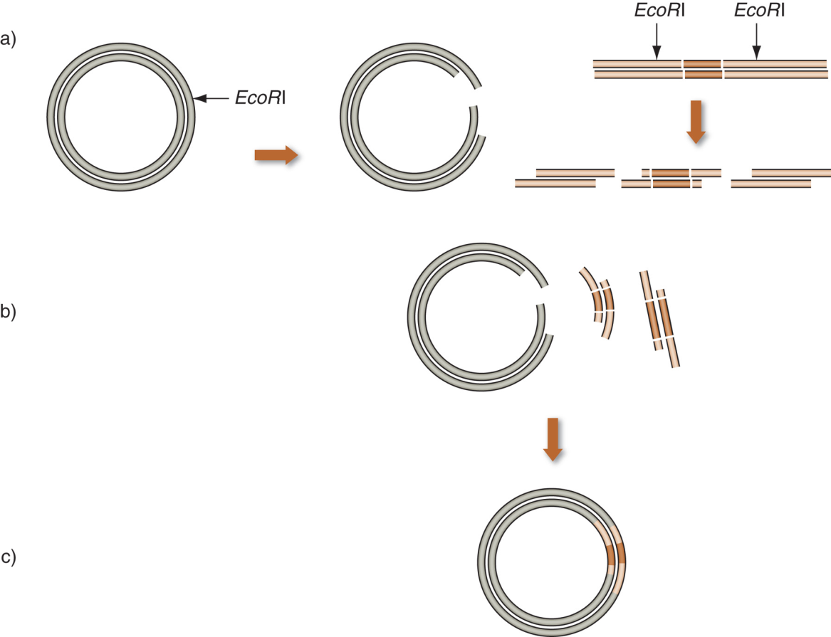
Nuts and Bolts of Genetic Engineering
Figure 10–3 DNA cloning.
Plasmid DNA and foreign DNA are cut with the restriction enzyme (EcoRI) to produce complementary sticky ends.
The digestion results in a linearized vector and a fragment of the foreign DNA containing the gene of interest.
The two fragments of DNA can join by base pairing, forming a circular molecule. DNA ligase will form covalent bonds to create the recombinant plasmid.

Slide 12
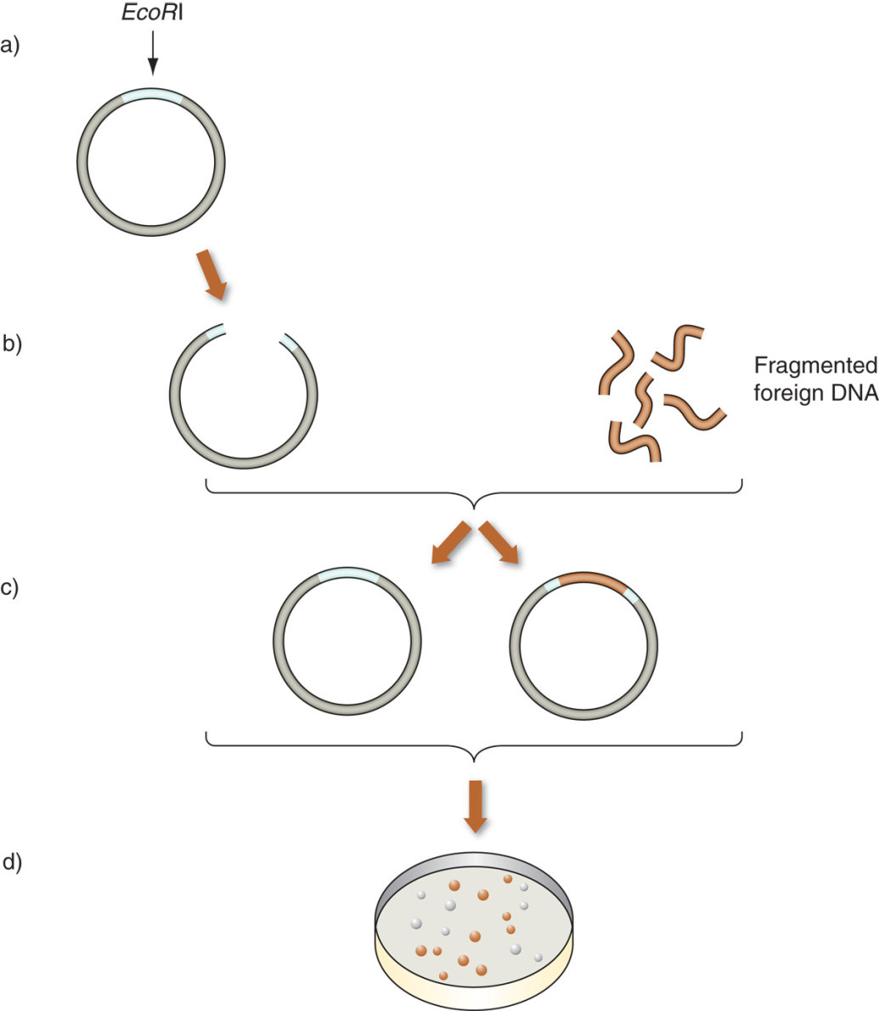
Nuts and Bolts of Genetic Engineering
Figure 10–4 Cloning foreign DNA into a plasmid and blue-white screening.
a) Plasmid vector is digested with a restriction enzyme that recognizes the restriction site.
b) The linearized vector is incubated with fragmented foreign DNA.
c) Following incubation, plasmid vectors will close with or without including foreign DNA.
d) Cells in the blue colonies do not carry any cloned DNA fragments, whereas the white colonies contain vectors carrying foreign DNA fragments.

Slide 13
Nuts and Bolts of Genetic Engineering
Polymerase Chain Reaction
The polymerase chain reaction (PCR) is a rapid and versatile method for amplifying target DNA sequences.
PCR amplifies small samples of DNA into large amounts, much as a copier makes many duplicates of one document.
The technique allows scientists to clone genes or gene fragments for identification and analysis, and it also allows for manipulation of an already identified gene.

Slide 14
Nuts and Bolts of Genetic Engineering
Polymerase Chain Reaction
The basic mechanism of PCR relies on a 3-step process:
Denaturation causes separation of the template DNA into single strands.
Annealing, allows primers (short nucleotide sequences) to bind (anneal) to the complementary bases at opposite ends of the target sequence.
Elongation allows DNA polymerase to copy the template DNA and to synthesize a complementary strand.

Slide 15
Nuts and Bolts of Genetic Engineering
Gene Mapping
Gene mapping refers to the creation of a genetic map by identifying genes at specific locations on chromosomes.
It is a critical step in the understanding of any genetic trait, whether a genetic disease or an economically important trait in livestock.

Slide 16
Nuts and Bolts of Genetic Engineering
Gene Mapping
There are two different ways of mapping:
genetic mapping, which uses crossbreeding experiments to determine the relative position of genetic markers or genes within a genome;
and physical mapping which uses molecular techniques to determine the absolute position of these markers or genes within the genome.

Slide 17
Biotechnology and/or Genetically Engineered Organisms
Applications of Biotechnology
Genetic engineering has greatly enhanced the process of introducing desirable genes into an organism by directly transferring the gene responsible for the beneficial trait.
Instead of crossbreeding for a number of years to acquire a desired trait, advanced molecular technology allows scientists to identify and insert a single gene responsible for a specific trait.

Slide 18
Biotechnology and/or Genetically Engineered Organisms
Applications of Biotechnology
Crops
Genetically modified crops outnumber all other genetically manipulated organisms (GMO).
GMOs provide a promising strategy for increasing global food production by reducing crop losses and increasing yields, while at the same time conserving the little unused farmland remaining.

Slide 19
Biotechnology and/or Genetically Engineered Organisms
Applications of Biotechnology
Crops
Transgenic plants are being created that have
enhanced nutritive value,
resistance to various pests and diseases,
ability to withstand adverse growing conditions,
resistance to herbicides,
unique ornamental value,
and edible vaccines.

Slide 20
Biotechnology and/or Genetically Engineered Organisms
Micropropagation
Micropropagation is a biotechnology that takes cells of a desired plant and uses them to generate another plant; this process is also called plant tissue culture.
Micropropagation can be combined with genetic engineering to produce large numbers of a plant that has been engineered to do something considered of value.

Slide 21
Biotechnology and/or Genetically Engineered Organisms
Micropropagation
Safety of Food and Feed Derived from Genetically Modified Crops
The safety of food and feed derived from genetically modified (GM) crops is assessed by internationally accepted procedures for evaluating any associated risks.
Scientific evidence continues to indicate that the risks associated with GM crops are not any greater than the risk posed by plants produced by traditional breeding methods.

Slide 22
Biotechnology and/or Genetically Engineered Organisms
Transgenic Animals
Whole Organism Cloning
Microinjection of cloned DNA into the pronucleus of a fertilized ovum continues to be a widely used method for producing transgenic animals.
There are many potential practical applications for the use of transgenic livestock, including
enhanced growth rates, improved carcasses, resistance to disease, enhanced feed efficiency, improved milk production, enhanced reproductive efficiency, and “gene pharming” for human medicine.

Slide 23
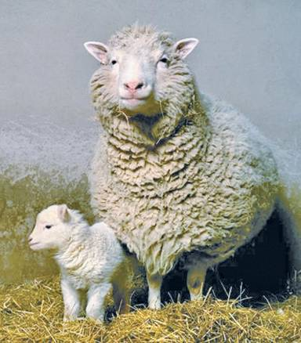
Biotechnology and/or Genetically Engineered Organisms
Transgenic Animals
Another technique is cloning by nuclear transfer from somatic cells.
This involves transplanting the nucleus from a somatic cell of the animal into an egg with the nucleus removed.
Figure 10–6 Dolly, the first cloned sheep produced through nuclear transfer . (Photo courtesy of, The Roslin Institute,The University of Edinburgh.)

Slide 24
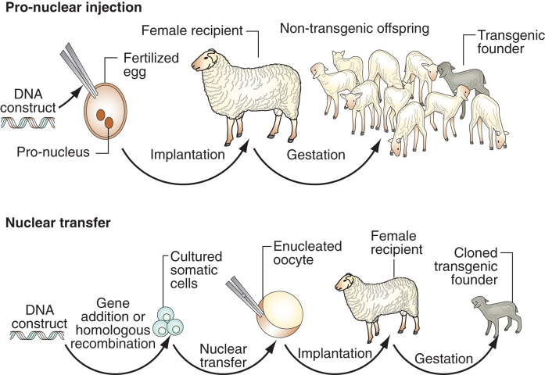
Biotechnology and/or Genetically Engineered Organisms
Figure 10–7 How to clone an animal.

Slide 25
Biotechnology and/or Genetically Engineered Organisms
Transgenic Animals
The potential advantages of cloned animals are many.
Cloning should prove useful in propagating transgenic animals.
Outstanding animals could be cloned for production purposes.
Combining cloning with rDNA technology is considered one of the great potential benefits of cloning.
The technique is considered to be extremely inefficient, but research is addressing this.

Slide 26
Livestock
Agricultural Applications
The production of transgenic livestock is a rapidly developing field that has the potential to impart nearly limitless benefits on the efficiency of animal agriculture.
Examples include:
modification of milk composition or production of novel milk proteins;
understanding control of growth and of carcass composition,
or producing environmentally friendly pigs.

Slide 27
Livestock
Disease Resistance
Genetic engineering is also being investigated as a tool to increase an animal’s ability to resist disease.
Transgenic dairy cows that are resistant to mastitis, an infectious disease of the mammary gland, are being produced.
Transgenic chickens and turkeys have been developed that resist avian diseases.

Slide 28
Livestock
Biomedical Applications
The production of pharmaceutical proteins in the blood or milk of transgenic animals is referred to as “gene pharming.”
Several products secreted in the milk of transgenic goats and sheep have advanced to clinical trials.

Slide 29
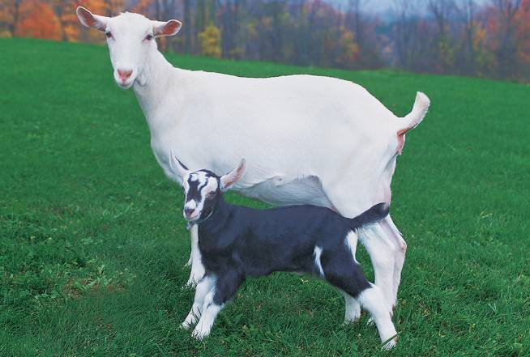
Livestock
Figure 10–8 On February 6, 2009, ATryn, an anticoagulant protein derived from the milk of transgenic goats, became the first animal drug to be approved in the United States. (Photo courtesy of GTC Biotherapeutics. Used with permission.)

Slide 30
Livestock
Biomedical Applications
Animal Engineered as Sources of Transplant Organs
Companies are actively pursuing the development of transgenic animals that could donate organs to humans that would not be rejected by the human recipient; this is called xenotransplantation.
Animals Engineered to Help Researcher Study and Treat Human Diseases
Several hundred transgenic rodent lines have been developed in order to study a myriad of diseases.

Slide 31
Transgenic Pets
The first transgenic pet marketed in the United States, the GloFish®, is a zebra fish (Danio rerio) that carries the fluorescent protein gene from a sea anemone.
The FDA found no evidence that these transgenic fish posed any greater threat than their non-genetically modified counterparts, either to the environment or to human health.

Slide 32
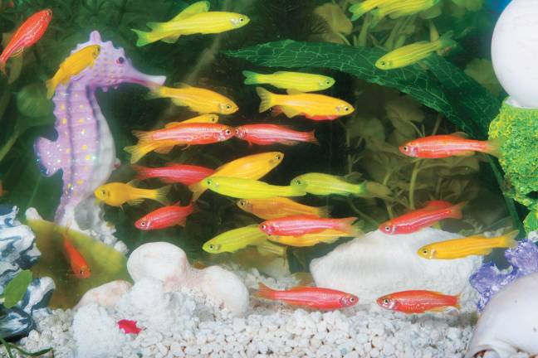
Transgenic Pets
Figure 10–9 The GloFish® fluorescent fish is a zebra fish (Danio rerio) that carries fluorescent protein gene from other marine organisms. (Photo courtesy of www.glofish.com. Used with permission.)

Slide 33
Medicine
Genetic Testing
Genetic tests involve direct examination of DNA molecules from blood or other tissues to find genetic disorders.
They are used by doctors for several reasons:
Prenatal diagnosis screening
Carrier screening
Sex determination
Identity/forensic testing
Embryo or newborn screening
Presymptomatic testing
Diagnosis confirmation

Slide 34
Medicine
Gene Therapy
Gene therapy is a technique for correcting defective genes responsible for disease development, by insertion, alteration, or removal of genes within an individual’s cells.
In most gene therapy studies, a normal gene is inserted into the genome to replace an abnormal, disease-causing gene.

Slide 35
Medicine
Pharmacogenomics
Pharmacogenomics is the study of how an individual’s inherited variation in different genes affects drug response.
Pharmacogenomics hold the promise of personalized medicine, when drugs and drug combinations will be tailor-made for individuals and adapted to an individual’s own genetic makeup.

Slide 36
Microorganisms and Recombinant DNA Technology
Drug and Vaccine Production
Biopharmaceuticals are pharmaceuticals produced using biotechnology; particular recombinant DNA in bacteria.
To date, the number of biopharmaceuticals on the market is just over 200; these include:
hormones and growth factors such as insulin,
antibodies such as TNF-α used to treat arthritis,
blood-related proteins,
and some vaccines.

Slide 37
Microorganisms and Recombinant DNA Technology
Drug and Vaccine Production
Vaccines for animals have been approved and used, including vaccines for:
rabies, baby pig scours, foot rot, sheep measles, and infectious bursal disease.
Recombinant bovine somatotropin (rBST) has been among the most successful products of genetic engineering made available to agriculture.
When administered to dairy cows, BST causes greater milk production.

Slide 38
Microorganisms and Recombinant DNA Technology
Biotechnology and Pest Management
Several bacteria have been genetically altered to improve their ability to kill or repel pests.
Bacteria Engineered for the Food Industry
Genetically altered microorganisms are used to facilitate food production, including cheesemaking and reduced timing for baking bread.
An emerging area of food biotechnology will include nutraceuticals, which are products that have both nutrient and pharmaceutical properties.

Slide 39
Societal Concerns
Biotechnology and genetic engineering have moral, ethical, and religious issues associated with them that society must reach conclusions about.
In the view of many, significant risks are posed by GM foods.
Policy debates over these and other related issues are sure to rage for the foreseeable future.

Slide 40
Summary and Conclusion
The term agricultural biotechnology is a broad term that describes the use of biological processes other than genetic engineering, such as micropropagation, plant and animal health diagnostics, vaccines, and biopesticides.
Safer foods, novel foods, cheaper foods, pharmaceuticals, diagnostics, and treatments all await the promise of biotechnology.

