Slide 1
Careers and Career Preparation in the Animal Sciences
Introduction to Animal Science:
Global, Biological, Social, and Industry Perspectives
W. Stephen Damron
Chapter 26

Slide 2
Learning Objectives
After studying this chapter, you should be able to:
Describe the general job market in agriculture and animal science.
Identity the general areas of curriculum in animal science and the careers associated with each area.
Develop a strategy for directing your education toward a satisfying career.

Slide 3
Introduction
The demand for college graduates with agriculturally related college educations has been strong and is expected to stay that way for the foreseeable future.
One of the reasons for the opportunities is that many jobs in great demand in agriculture would not have been recognized as agricultural in the recent past.

Slide 4
Introduction
Agriculture was hard-pressed to find enough good people to fill its positions during most of the 1990s and 2000s, and the same trend is anticipated through the second decade of the new century and beyond.
Many see the lack of college graduates as the most limiting factor in agriculture’s growth.

Slide 5
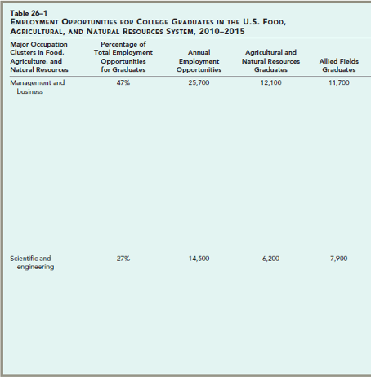
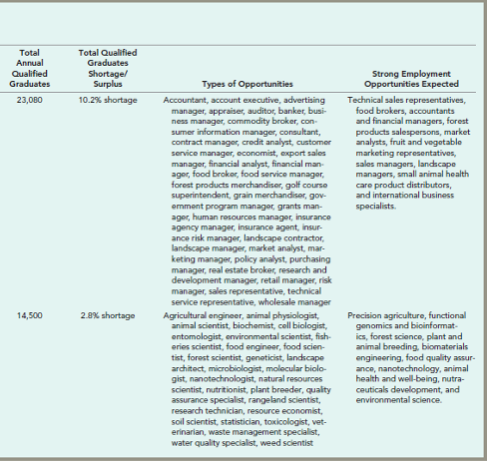
Introduction

Slide 6
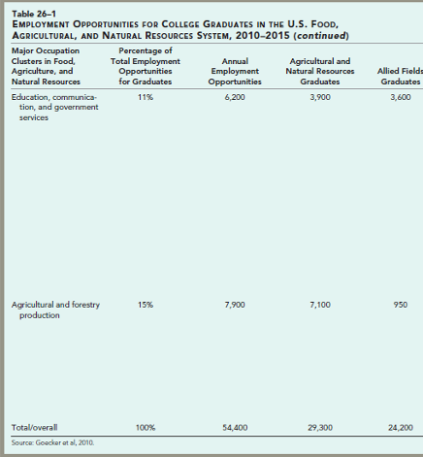
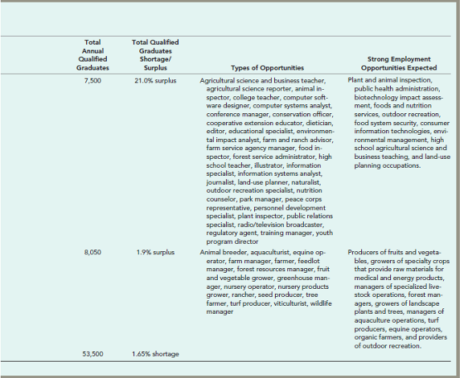
Introduction

Slide 7
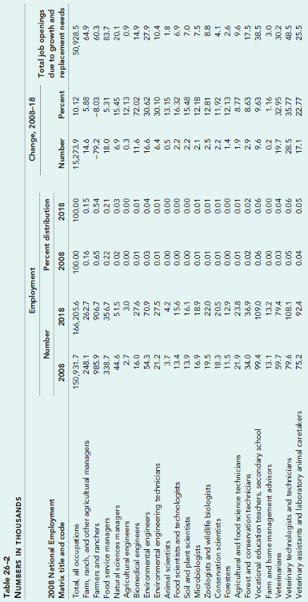
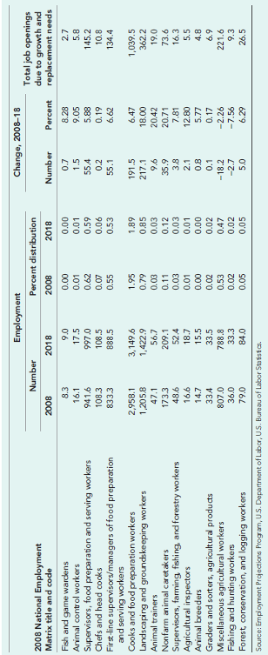
Introduction

Slide 8
Animal Science Studies and Careers
Students vary in their approach to animal science and in what they want out of their education as it prepares them for a career.
Some students, perhaps even the majority, are primarily interested in a specific animal species.
Others are more interested in a career track and less interested in a specific species.
Others are more interested in a career track and less interested in a specific species.

Slide 9
Animal Science Studies and Careers
Production
The primary goals of those in production are to improve the quality of agricultural products and the efficiency of farms.
College curricula designed to prepare students for careers in production generally stress more husbandry practices than do the other approaches, but they also include supporting course work to help a student prepare for specific production positions.

Slide 10
Animal Science Studies and Careers
Production
A large number of good opportunities exist and will continue to exist in production positions and on farms and ranches throughout the country.
However, the general trend to larger and fewer production units is causing a decrease in the number of available positions.

Slide 11
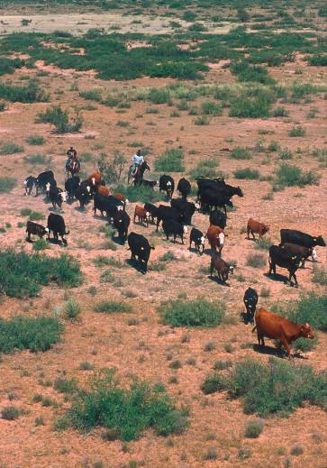
Animal Science Studies and Careers
Figure 26–1
For many students, the goal of their education is to own or manage a farm or ranch. (Photographer Scott Bauer, Courtesy USDA-Agricultural Research Service.)

Slide 12
Animal Science Studies and Careers
Science and Medicine
Agriculture is scientifically based and scientifically dependent.
Perhaps because of the rigor of science-based curricula, perhaps because so many other opportunities exist, or perhaps because additional years in school are usually needed, this general area of agriculture and animal science is barely producing enough graduates.

Slide 13
Animal Science Studies and Careers
Science and Medicine
The work of animal and food scientists helps to improve agricultural productivity and efficiency.
Those in the science area use biology, chemistry, physics, mathematics, and other sciences to meet challenges in animal science, with foods, and in the companion animal market.

Slide 14
Animal Science Studies and Careers
Science and Medicine
One very popular career opportunity that animal science can lead to is that of veterinarian.
The majority of veterinarians are in private practices where they pursue the clinical work necessary for the prevention, diagnosis, and treatment of diseases, disorders, and injuries in animals.
About half of these veterinarians are predominantly or exclusively small-animal practitioners.
Most of the remaining veterinarians are in mixed-animal practices or exclusive large-animal practices.

Slide 15
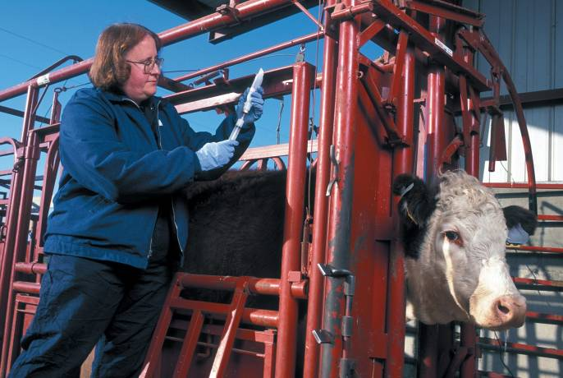
Animal Science Studies and Careers
Figure 26–4 A USDA-ARS veterinarian prepares to inject a cow with an experimental vaccine. (Photographer Keith Weller, Courtesy USDA-Agricultural Research Service.)

Slide 16
Animal Science Studies and Careers
Foods
The food industry represents one of the most significant areas of current and potential employment in animal science and all of agriculture.
Concerns over food safety and changing demographics relating to how we eat will keep demand high for this area.

Slide 17
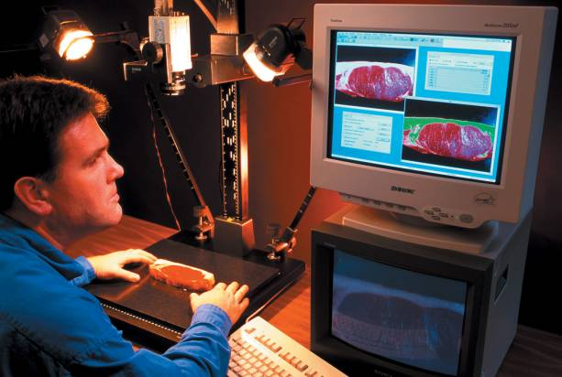
Animal Science Studies and Careers
Figure 26–6 Because of the science and engineering know-how needed to produce a safe, convenient, and economical food supply, career tracks for those with advanced degrees are plentiful in the foods industry.
(Photographer Keith Weller. Courtesy of USDA-Agricultural Research Service.)

Slide 18
Animal Science Studies and Careers
Agribusiness
Agribusiness careers have proliferated over the last two decades as all of agriculture has taken the structure of the big business it is.
These careers require a knowledge of the animal industries, but they also require business acumen, skilled communication, and people skills.

Slide 19
Animal Science Studies and Careers
Agribusiness
This area represents an opportunity for many more graduates because colleges and universities are chronically short of qualified graduates for these positions, with little prospect of catching up anytime soon.
These are intensely people-related jobs and, for many people, they offer the best of both worlds for career opportunities.

Slide 20
Animal Science Studies and Careers
Communication and Education
A combination of strong communication skills and technical knowledge in animal science, foods, or other agricultural disciplines prepares students for careers as communication and education specialists.
Many colleges and universities have recognized that traditional programs have not kept up with the needs of people who will fill these roles in life.

Slide 21
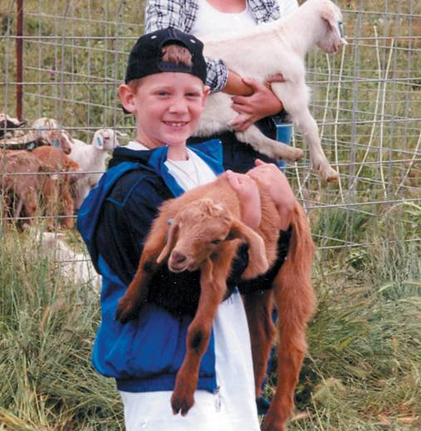
Animal Science Studies and Careers
Figure 26–7
The animal industries offer many opportunities, among them the opportunity to work with both animals and young people in vo-ag and 4-H programs.
(Photo courtesy of Dr. Rebecca L. Damron. Used with permission.)

Slide 22
Animal Science Studies and Careers
Animal Caretakers
Universities, commercial laboratories, pharmaceutical companies, animal hospitals and clinics, kennels, animal shelters, stables, and zoos and aquariums employ animal caretakers.
Many of these jobs require no formal training but rely on on-the-job training. However, advancement can depend on both experience and/or formal training.

Slide 23
Animal Science Studies and Careers
International Opportunities
As the world has become increasingly open and accessible to trade, cultural exchange, and humanitarian intervention, more and more opportunities are created for those who wish to work in the international arena.
A wealth of international exchanges, study tours, and study abroad opportunities are available at colleges and universities around the United States.

Slide 24
Trends Affecting Employment
Consumer Demands
Consumers are increasingly demanding more specific products and services which requires specific expertise in production, marketing, and distribution to meet consumer demands.
Changing Industry Structures
The U.S. food system is big business with well-developed business structures in place to produce, collect, process, and distribute its products.

Slide 25
Trends Affecting Employment
Science and Technology
The current rate of advancement in science and technology is having profound effects on employment.
Public Policy
We are in an unprecedented era of public policy regarding the food we eat and the system that provides it, especially regarding energy, food safety, diet and health, and environmental protection.

Slide 26
Trends Affecting Employment
Global Changes
Markets are shifting, incomes are rising in much of the world, and food is in greater demand (volume and quality) due to increased populations and increased income levels.
A look at the statistics for the increased exports of agricultural products from the United States to points around the globe offers a window into the changing world marketplace.

Slide 27
A Job, a Career, a Lifetime
Certainly one of the most important and difficult decisions we ever make in life is our choice of a career.
There are usually competing motives at work trying to sway our choice, making it a difficult decision.
All of this can be very confusing and disconcerting, leaving us in a position of indecision.
This is one of those life decisions that calls for a plan.

Slide 28
A Job, a Career, a Lifetime
First of all, choose an occupation you can enjoy.
To continue doing something for a lifetime and not get burned out on it, we have to gain satisfaction from what we do.
Perhaps the most important part of the process is to adopt the attitude that this is a tentative choice.
As a safety net, develop a Plan B that includes other career areas that also interest you.

Slide 29
A Job, a Career, a Lifetime
Don’t neglect the areas that transcend a specific focus of study like:
leadership, communication, problem-solving, and communication skills along with a personal philosophy and work ethic.
It also helps to be aware that an education is more than job training.
An education should also add quality to life in ways not associated with a career.

Slide 30
A Job, a Career, a Lifetime
Education works best if students make best use of the resources available to them.
Some of your best resources can be found in your professors and advisers.
As advisers and faculty members, we can tell you what is important.
However, we can’t make you do any of it.

Slide 31
Summary and Conclusion
Career opportunities are available in agriculture and its component parts.
In animal sciences, students may choose a production, science and medicine, or foods or agribusiness orientation.
Ultimately, a career is a personal choice filled with personal and professional responsibility.

